Slide 1
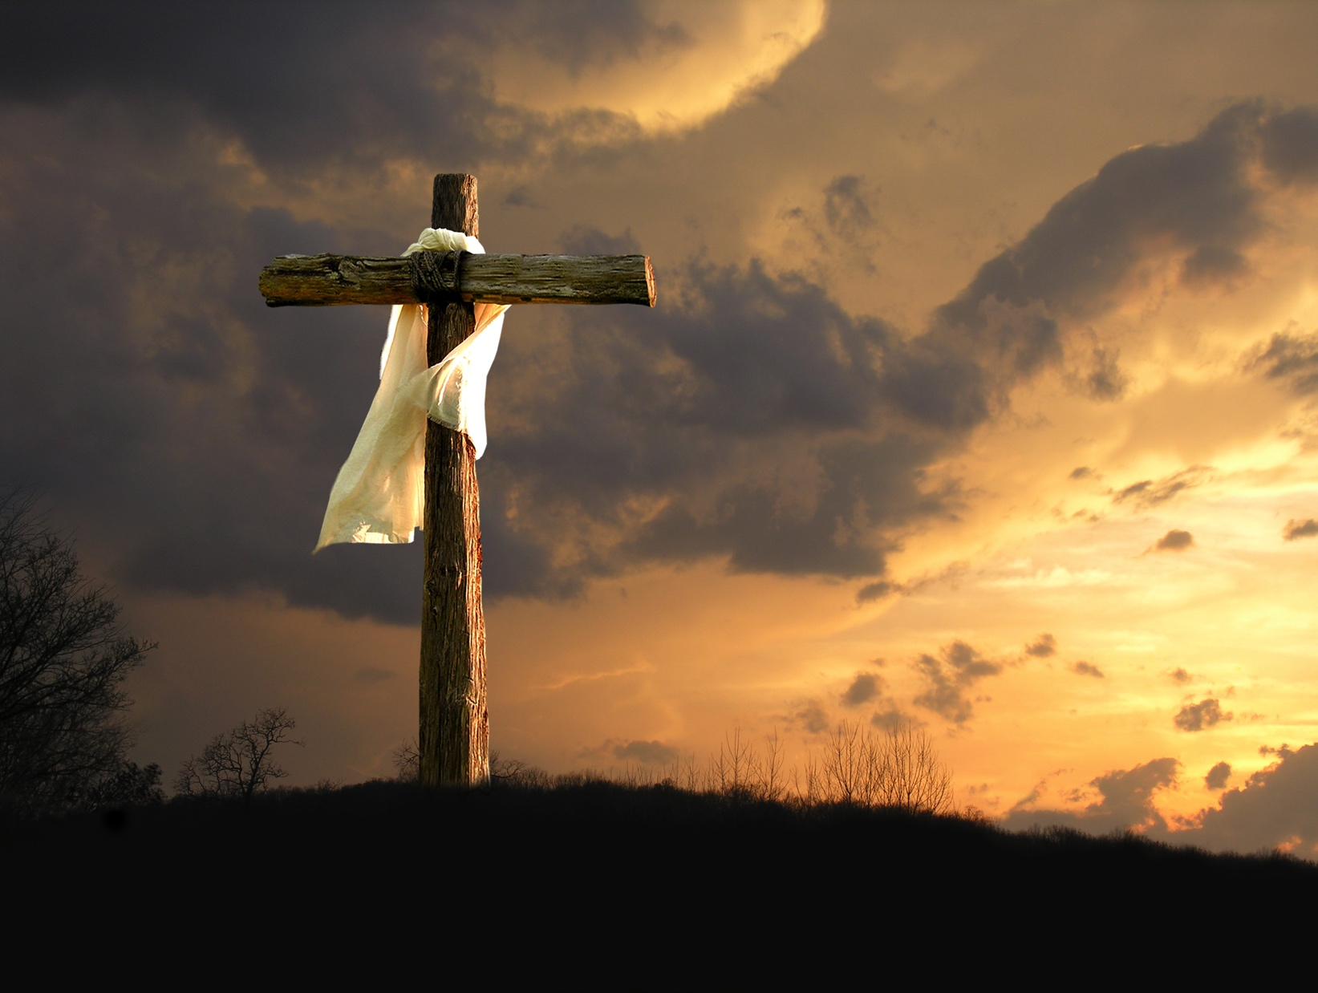

Is there scientific evidence for Resurrection of Jesus Christ?
From Content by Father Robert Spitzer, S.J., Ph.D. with adaptations for McGrath Institute Summer 2021 by Martin Lindway, Ph.D.(Cleveland Benedictine High School)
Notes:
Credible Catholic presents the 7 Essentials: Module 4 Appendix – The Shroud of Turin

Slide 2

Opening Prayer
Lord, please guide our minds and open our hearts as we examine the evidence for the life, death, and Resurrection of Jesus. ​
Amen.
Notes:
Lord, please guide our minds and open our hearts as we examine the evidence for the life, death, and Resurrection of Jesus. ​
Amen.

Slide 3

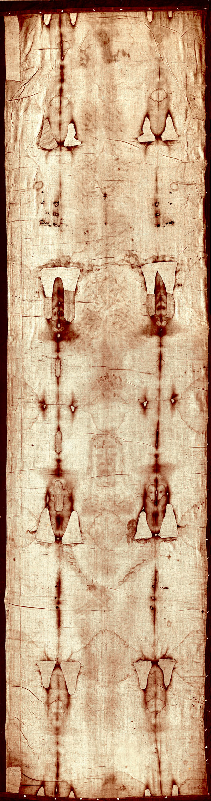
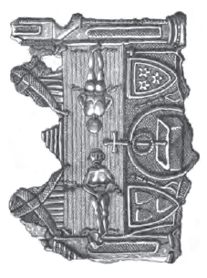
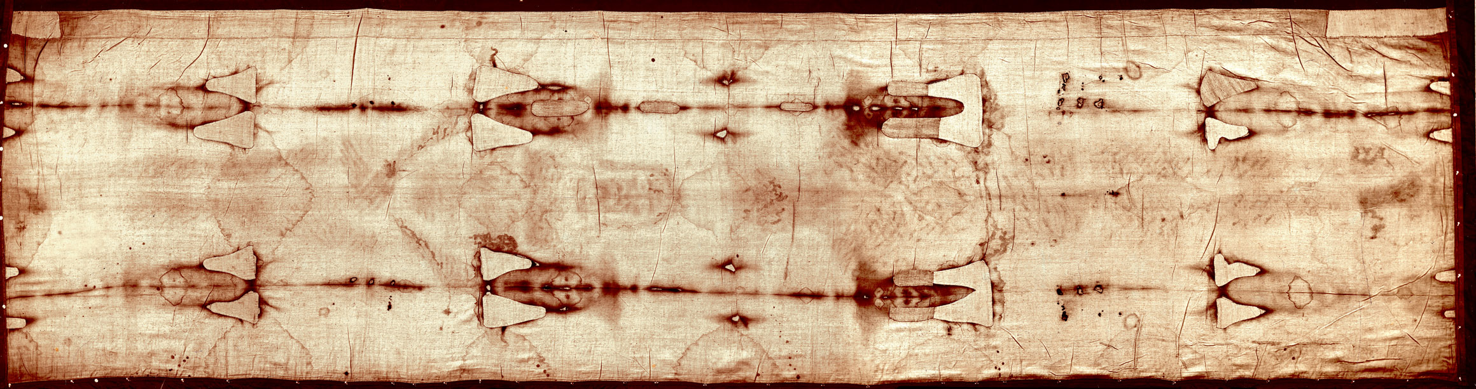
So, who has seen this image before?
Let’s briefly discuss what you may know at this point?
Notes:
So what is the Shroud? The Shroud of Turin is a linen burial clot, which surfaced in Lirey, France in 1349 AD.

Slide 4
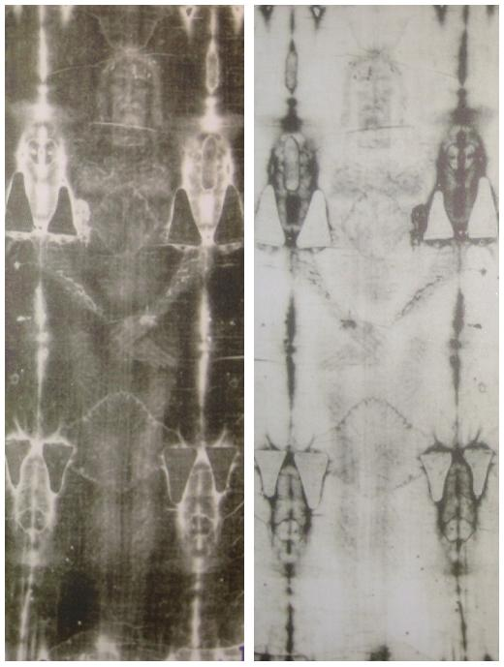
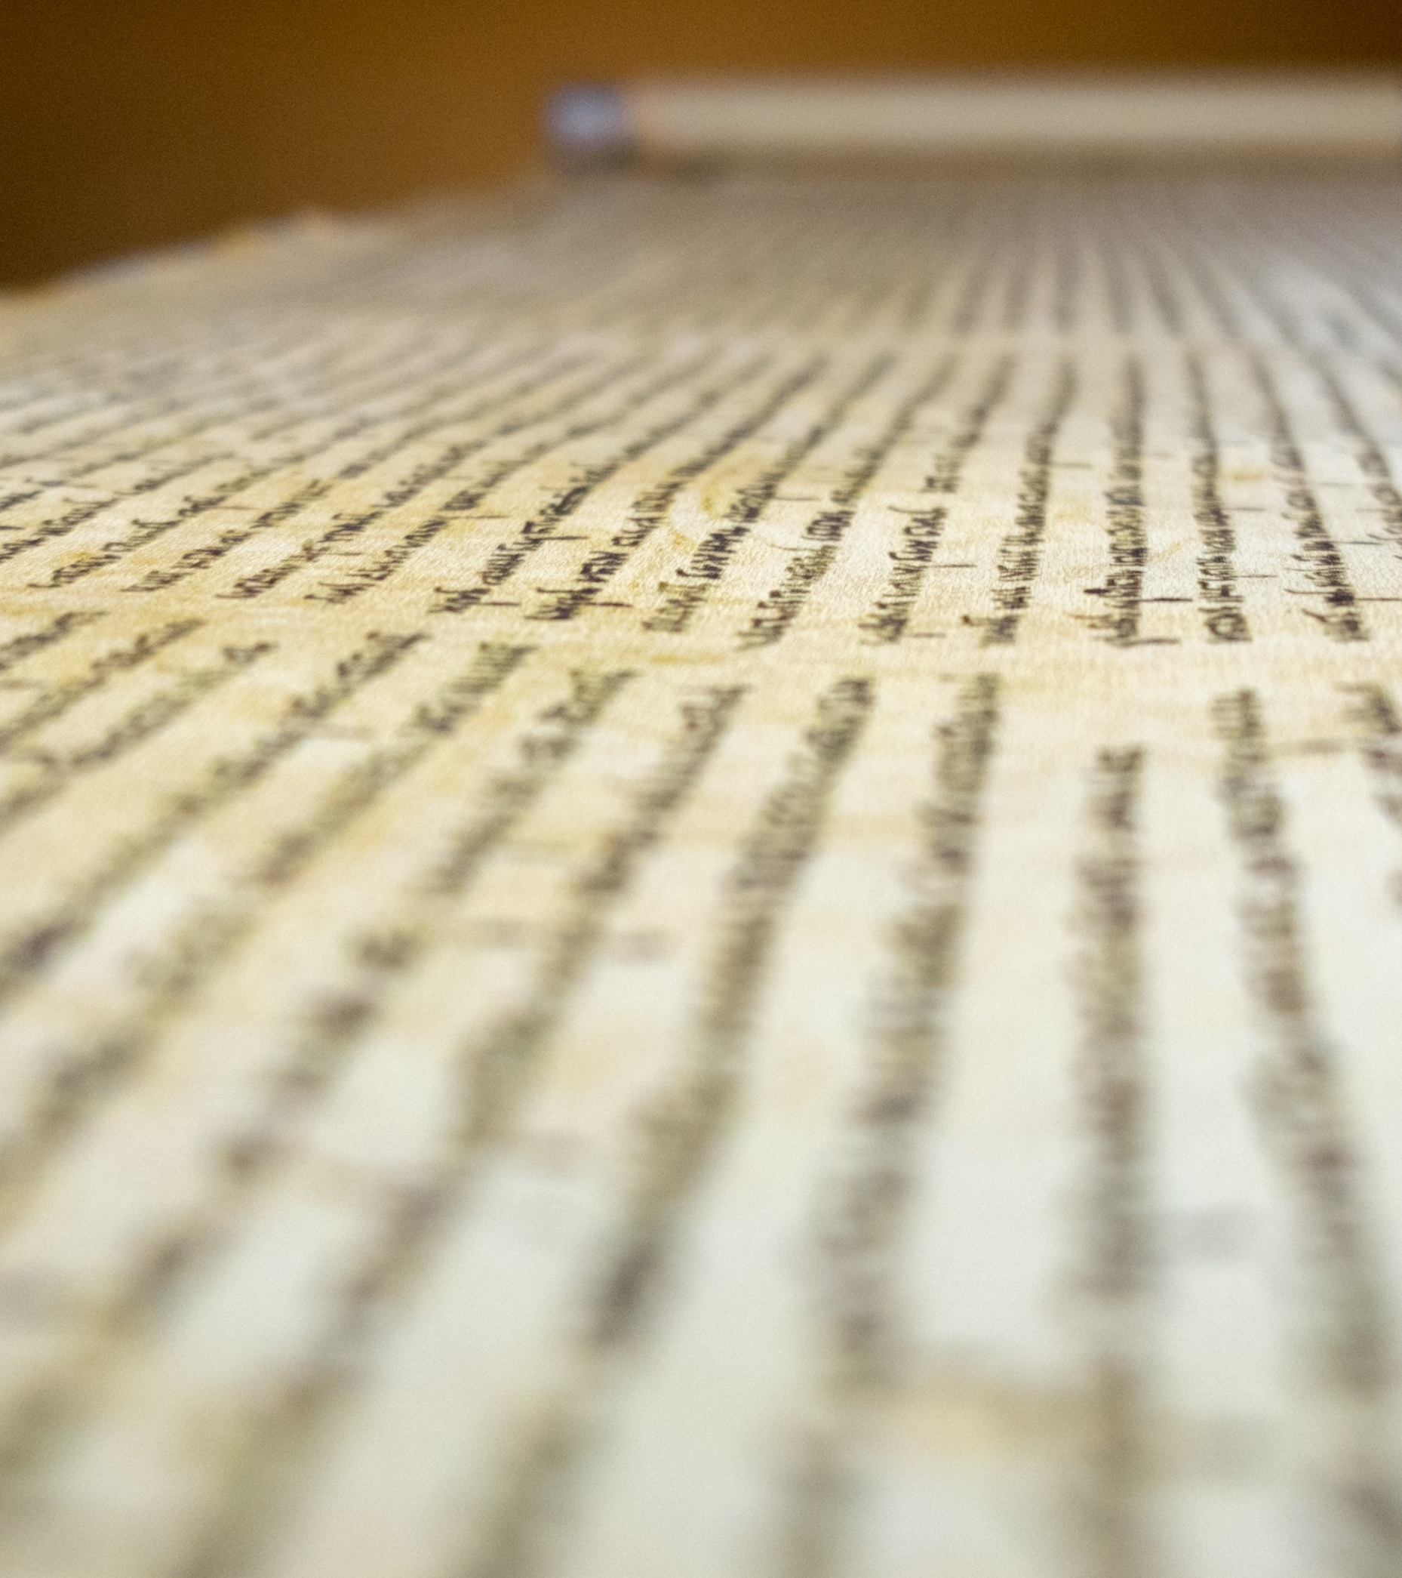
One should thoroughly examine the broad sources for corroborative evidence to truly appreciate reasonable grounds for belief in:
Jesus' Resurrection and
Jesus’ Divinity
These sources include non-biblical and peer-reviewed scientific findings to support our theological understanding for these belief based on biblical accounts.
We’ll be focusing our discussion now on the scientific findings of a most interesting
scientific artifact
which provides further corroboration to the broader set of evidence claiming Jesus’ Resurrection and Divinity.
Yet, we must keep in mind science cannot prove much with final certainty!
Notes:
The evidence we've reviewed in this module gives us reasonable grounds for belief in Jesus' Resurrection, His Divinity, and His gift of the Holy Spirit. In this section, we're going to close by looking at an interesting scientific artifact which isn't necessary for the above evidence but can give some additional corroboration of it. That artifact is the Shroud of Turin, which at least some scientists believe to be the burial shroud of Jesus.

Slide 5
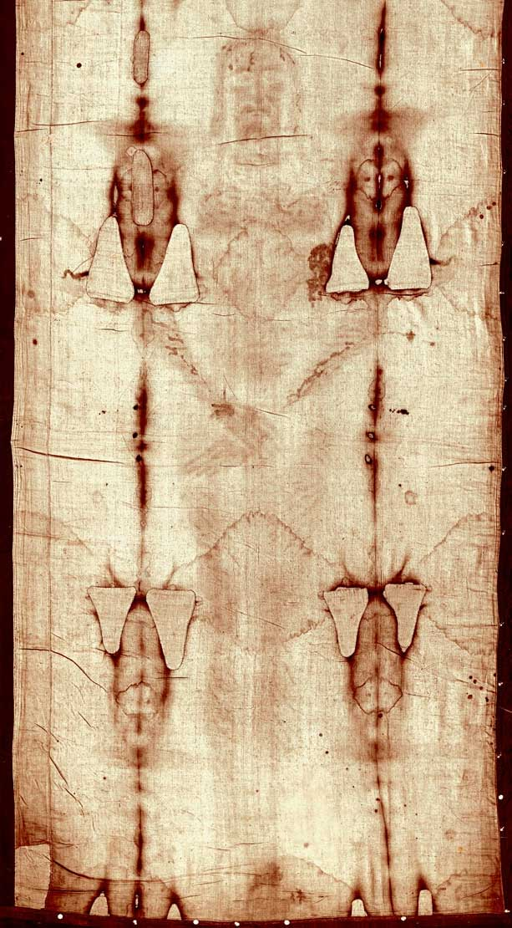
That artifact is the Shroud of Turin, is the most studied object by scientists in history, leading many scientists who have thoroughly investigated the evidence to believe it to be the burial shroud of Jesus.
Thorough scientific examination of the Shroud can provide a more detailed understanding of the severity Roman style scourging and crucifixion, Jewish burial, and even Jesus’ Resurrection and his divinity.
Notes:
The Shroud is an image with many unique properties, some of which have been discovered through the numerous scientific tests the Shroud has undergone. We don't yet have conclusive proof of its authenticity, so like any unexplained scientific phenomenon, we must be careful not to ground our faith in it. However, the Shroud can still potentially shed some interesting light on the events surrounding Christ's death and burial, and even his resurrection.

Slide 6
So what is the Shroud?
The Shroud of Turin is a linen cloth with unique characteristics common for a 1st century burial shroud based on Jewish custom and laws:
Dimensions: 4 by 2 cubits (roughly 14 by 3.5 feet)
3:1 herringbone patterns
“fault” consistent with practiced production techniques
fibers made from lignin (lignocellulose)
Notes:
So what is the Shroud? The Shroud of Turin is a linen burial clot, which surfaced in Lirey, France in 1349 AD.

Slide 7
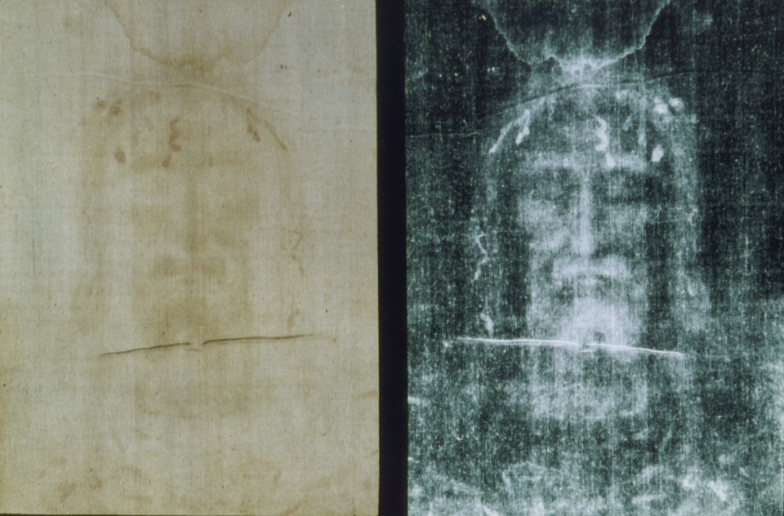
What do you know of The Shroud of Turin ?
If you like more background, one can find a few outstanding documentary of The Shroud of Turin via FORMED.org link, a good place to start is the 1978 film The Silent Witness; provides one an awareness and excitement of discovery of the authenticity of The Shroud of Turin by broad team of historians, scientist and medical professionals.
A list of other more recent videos on The Shroud of Turin can be found by cut and pasting Bit.ly/ShroudVideos in your browsers address line
(Formed.org offers a free 30 day trial or your parish may provide you free access)
Notes:
The current understanding of the laws of physics cannot explain a transition from a physical to a spiritual body or a burst of several billion watts of light energy from a corpse. So what are our options?
We can reasonably infer the strong possibility that there’s a supernatural cause—or
We can wait for a whole new explanation of physics and chemistry that might emerge in the future to solve the mystery.

Slide 8
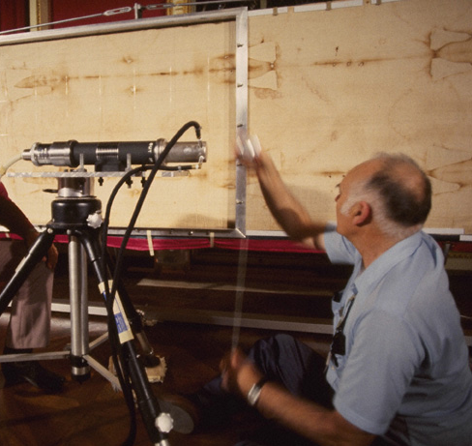
Photo ©1978 Barrie M. Schwortz Collection, STERA, Inc.
From all of these scientific investigations, scientists have unveiled several mysteries surrounding The Shroud which are exceedingly difficult to explain by natural causes and science.
This implies the possibly and even likelihood of a supernatural cause, since science can only test for natural effects to infer natural causality.
Notes:
In the midst of all this, scientists have unveiled several mysteries surrounding the shroud which are hard to explain with current scientific models. They raise the prospect of a supernatural cause, although this is strictly a matter of interpretation since science by definition can only test for natural causes.

Slide 9
Most Striking Feature
The Shroud contains a perfect three-dimensional, photographic negative image of a scourged and crucified man. (Spoiler alert . . .)
This image is so accurate that modern medicine can analyze and diagnose in detail the extent of afflictions suffered prior to moment of death.
Image revealed by photographic negative
Actual Shroud
Notes:
The shroud contains a perfect three-dimensional, photographic negative image of a crucified man. This image is so accurate that modern medicine can diagnose many of the injuries by analyzing it.

Slide 10

What do you notice about this image?
What are your initial thoughts, looking at it?
Let’s discuss

Slide 11
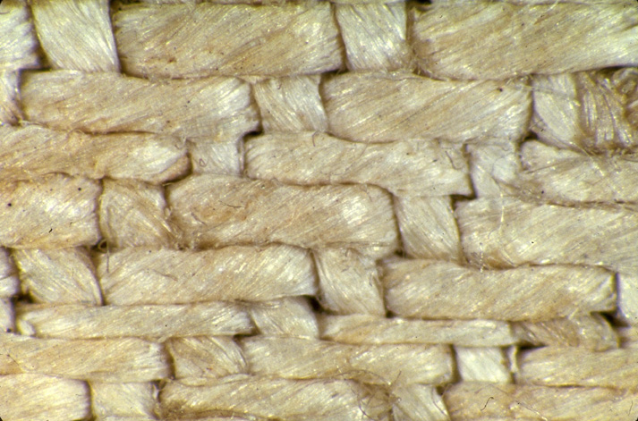
Photo Closeup (Eye) ©1978 Mark Evans Collection, STERA, Inc.
The biggest mystery is the image itself - scientific tests show the image was not produced by any of today’s known technologies (ie. paints, dyes, chemicals, vapor, scorching, etching or any other known techniques!)
Image-Closeup(Eye)
Notes:
The biggest mystery is the image itself - scientific tests show the image was not produced by any paint, dye, chemical, vapor or scorching.

Slide 12
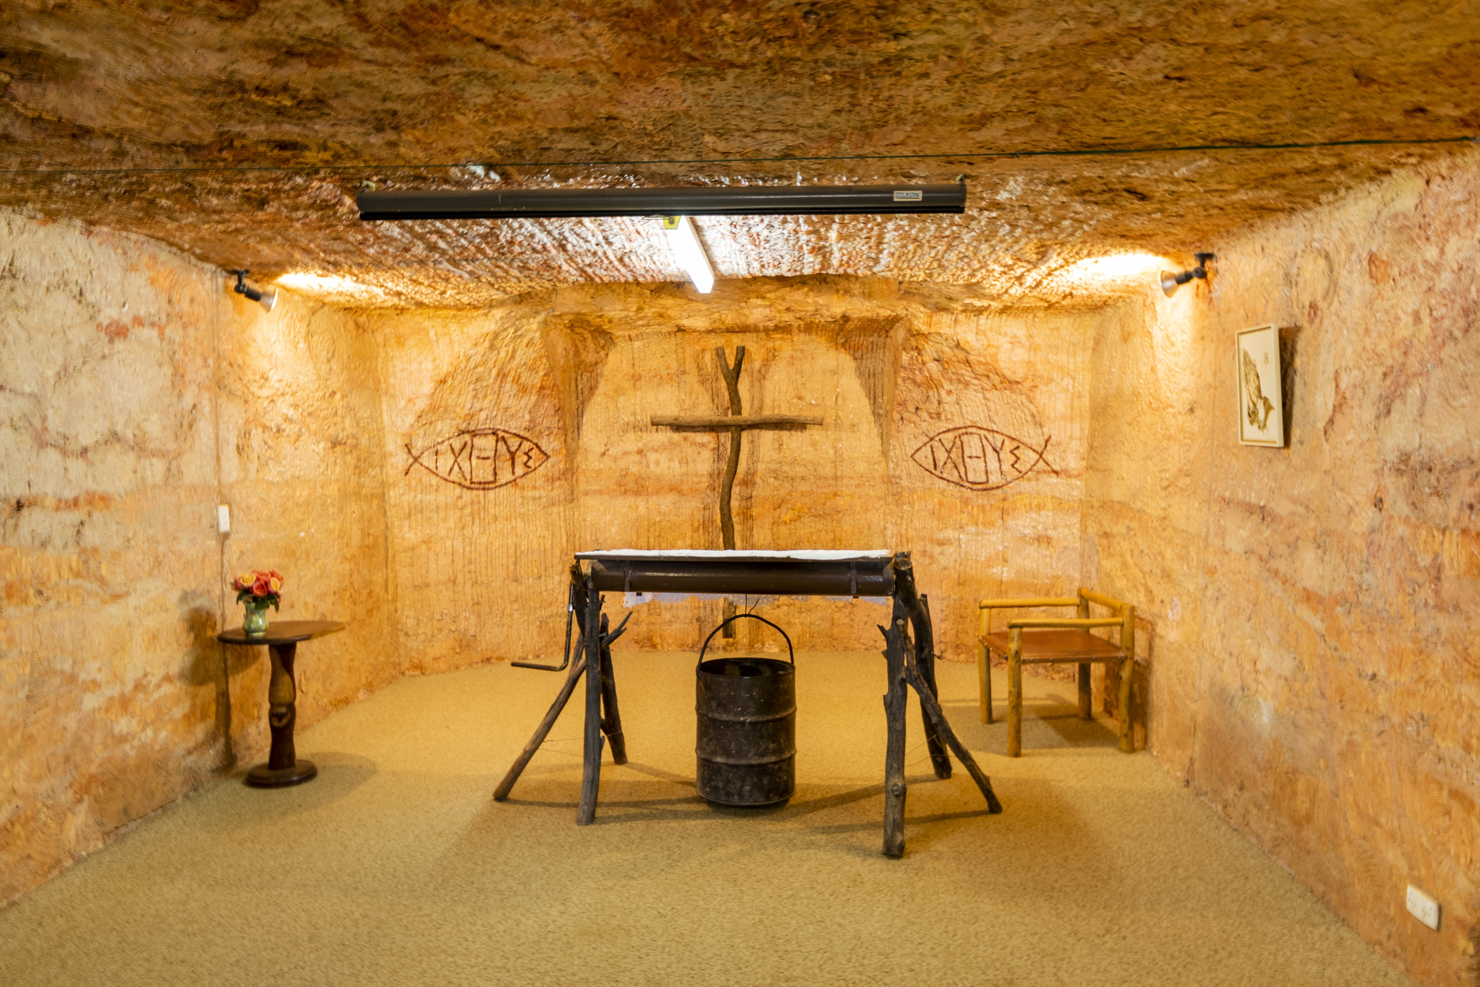
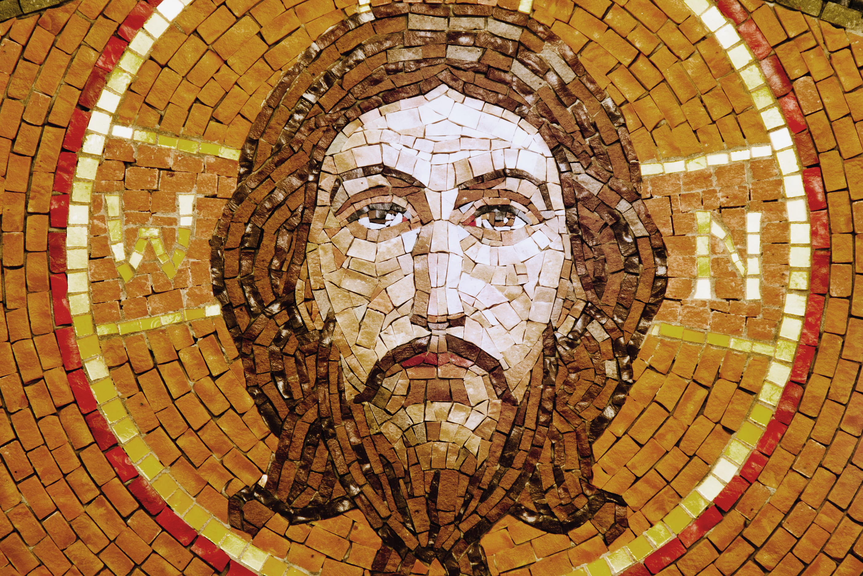
Various tests done on the shroud suggest
that it could be the burial shroud of Christ,
due to the combination of three kinds of evidence:
Anatomical details that correspond to the unusual set of injuries described in the gospels, historical Roman-style crucifixions, and relative images of Christ
Ultra, ultra high-energy image formation implying a spiritual and glorious Resurrection
Dating analyses that place it at the time of Christ

Slide 13
The Blood Stains
The Shroud has hundreds of bloodstains suggestive to the specific method and severity of scourging Jesus received.
The bloodstains match up anatomically with the image,
but the image had to have formed after the blood congealed on the cloth! This is a key piece of scientific evidence supporting the deduced claim of a later resurrection event.
Notes:
In addition to the image, the Shroud has hundreds of bloodstains (suggestive of the whippings Jesus received). The bloodstains match up anatomically with the image, but the image was formed after the blood congealed on the cloth. In other words, a potential forger would need to place all the bloodstains before there was an image to match them to.

Slide 14
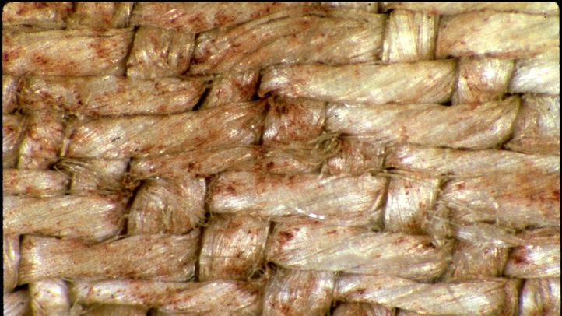
Photo ©1978 Mark Evans Collection, STERA, Inc.
The bloodstain analysis provided:
normal profile of blood components
blood type (AB+)
partial DNA profile of a male
critical biological markers
Critical biological markers of the bloodstains: Higher concentration of bilirubin manifesting a brighter red color on the fibers vs. dark brown
Concentrations levels of specific enzymes (creatinine and ferritin) indicative of a body’s response to trauma and torture
Notes:
The bloodstains are genuine, with hemoglobin, an AB positive blood type, and a partial DNA profile of a male. The blood even contains biological substances called enzymes (specifically, creatinine and ferritin) indicating trauma and torture.

Slide 15
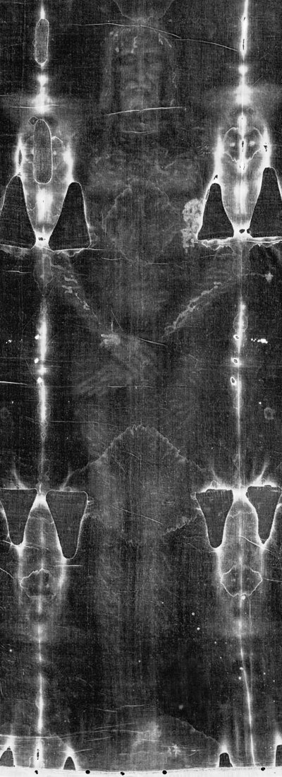
Together, the blood and image indicate
the Shroud was wrapped around a real man
who was
Crucified
Crowned with thorns
Flogged
Pierced in the side by a lance similar to a Roman lance
This unusual combination of wounds is similar to the crucifixion of Jesus described in the gospels and a unique historical Roman-style crucifixion
These wounds on the shroud were first detailed in Dr. Pierre Barbet's A Doctor At Calvary
and analyzed in later studies by Dr. Frederick Zugabe and others.
Notes:
Together, the blood and image indicate the Shroud was wrapped around a real man who was crucified, crowned with thorns, flogged, and pierced in the side by a lance similar to a Roman lance. This unusual combination of wounds is similar to the crucifixion of Jesus described in the gospels. These wounds on the shroud were first detailed in Dr. Pierre Barbet's A Doctor At Calvary and analyzed in later studies by Dr. Frederick Zugabe and others.

Slide 16
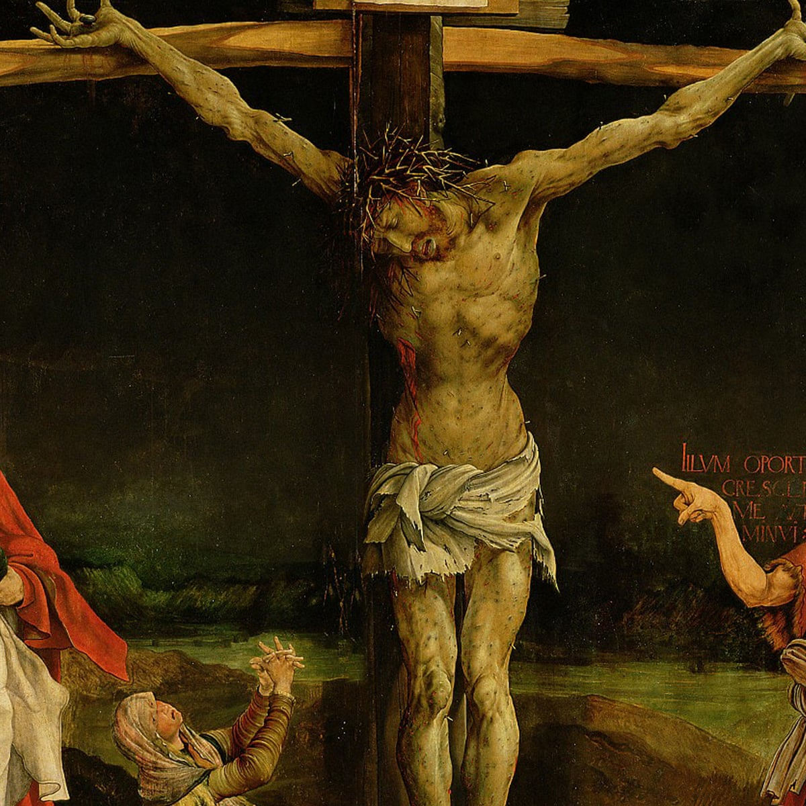
What does the Shroud reveal of the reality of Jesus’ Passion and Crucifixion?​
We will now look at the evidence of the wounds
which seem to connect
the Shroud
to the unique details
of Jesus' crucifixion.
Notes:
Now let's look at the evidence of the wounds, which seem to connect the Shroud to the unique details of Jesus' crucifixion.

Slide 17
The man on the Shroud was punctured over 20 times by a crown with long thorns
covering his head like a helmet.
Notes:
The man on the Shroud was punctured by over 20 times by a crown with long thorns covering his head like a cap.

Slide 18
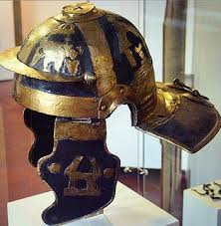
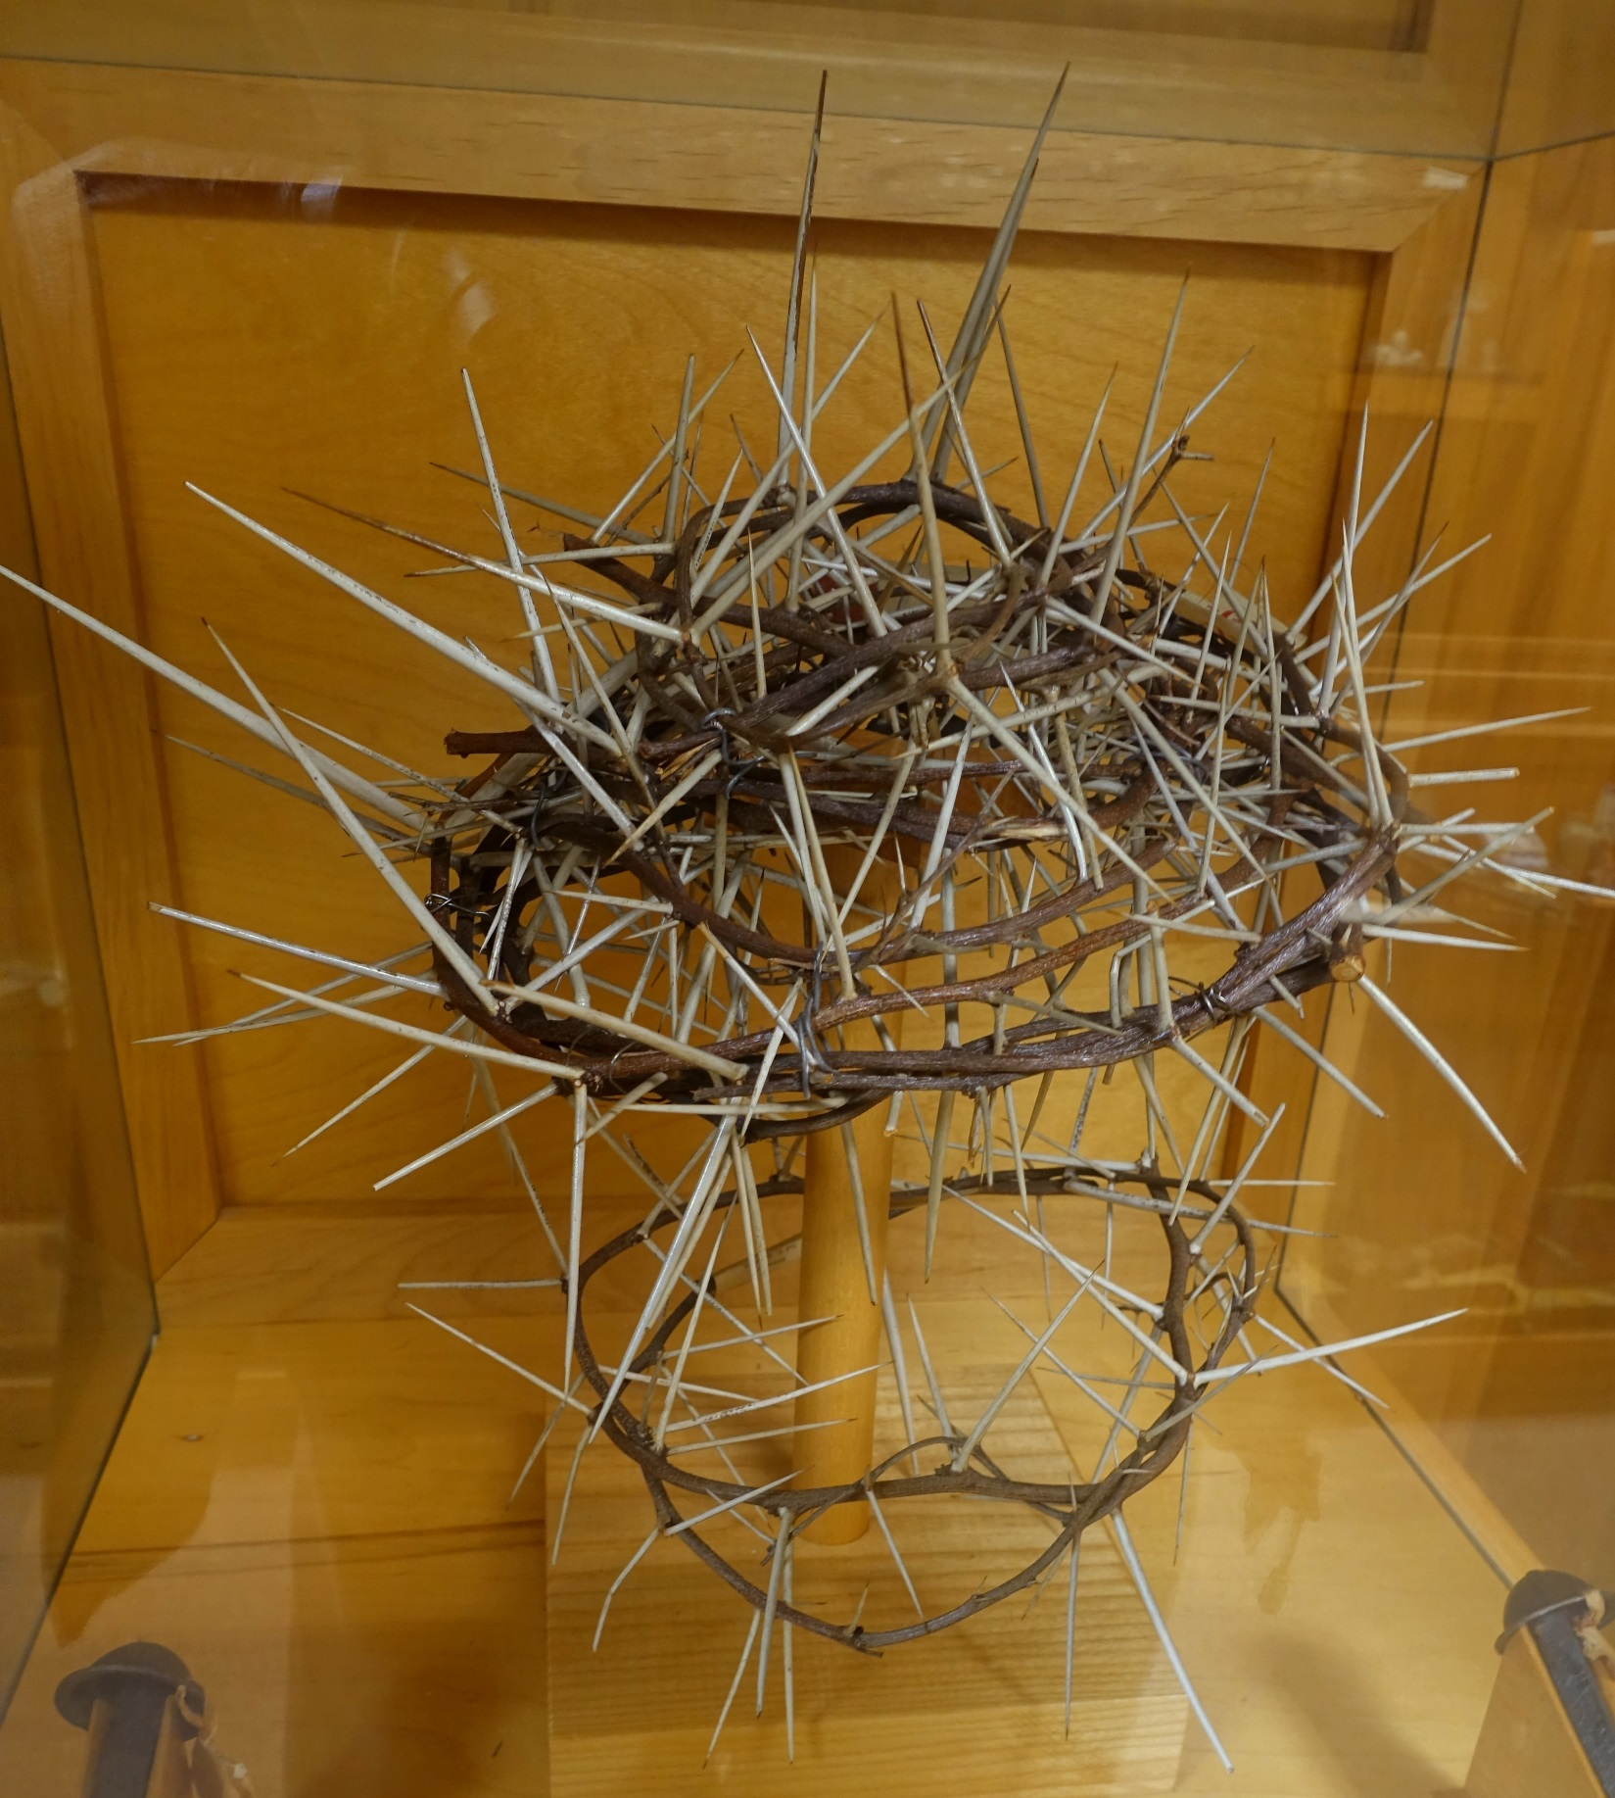
This was a very distinctive element connecting Jesus' crucifixion to the proclamation of the crime written above him on the cross
“Iesvs Nazarenvs Rex Ivdaeorvm” (Jesus of Nazareth, the King of the Jews)
Notice reproduction of the crown is more in the shape of Roman military helmet fashioned by one of soldiers, which most Christian artists would not have been aware of or appreciated in attempts for a more realistic rendering of the crucified Christ.
Reproduction made with thorns from Jerusalem
Notes:
This was a unique element of Jesus' crucifixion, specific to the accusation against him of being "King of the Jews", notice that this kind of crown (in the shape of a cap) is Roman, and is not used in Christian art and would not have been known to a medieval forger.

Slide 19
The man on the Shroud has an elliptic wound between his ribs matching the dimension of a leaf-shaped lance carried by Roman soldiers.
The wound to region of pericardial sac would issued both blood and a watery clear substance found in the chest under stress, and observed on the Shroud.
Notes:
The man on the Shroud has an elliptic wound between his ribs matching the leaf-shaped lance carried by Roman soldiers. The wound issued both blood and a watery substance which might have been clear liquid found in the chest under stress.

Slide 20
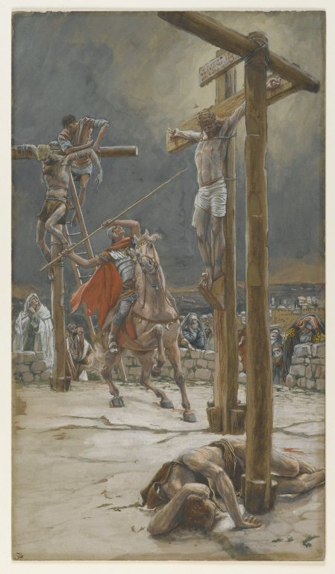
The lance wound is unique to Christ's crucifixion - usually, misery was prolonged during crucifixion but the lance was used to make sure Jesus was dead before the Passover.
The gospel's mention of blood and water flowing out of Jesus’ side (John 19:34) is another unexpected detail that seems to match the Shroud.
Notes:
The lance wound is unique to Christ's crucifixion - usually, life was prolonged during crucifixion but the lance was used to make sure Jesus was dead before the Passover. The gospel's mention of blood and water flowing out of Jesus’ side (JN 19:34) is another unexpected detail that seems to match the Shroud.

Slide 21
The man on the Shroud was scourged about 39 times by a Roman flagrum, a whip with three strands (with bone chips and metal shards on the ends), leaving 117 marks and stains in total.
This whip was used by Roman legionnaires for torture and execution of criminals (as found in archeology sites like Pompeii).
Notes:
The man on the Shroud was scourged about 39 times by a Roman flagrum, a whip with three strands (with bone chips and metal shards on the ends), leaving 117 marks and stains in total. This whip was used by Roman legionnaires for torture and execution of criminals (as found in archeology sites like Pompeii).

Slide 22
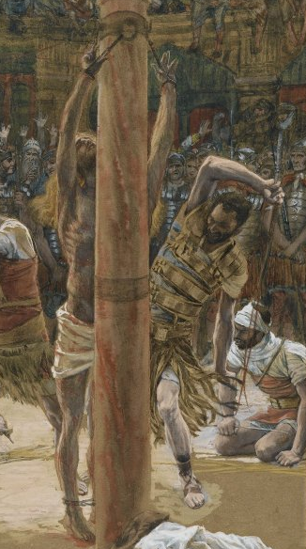
Jesus was probably scourged in this way by Roman soldiers (according to Gospel accounts).
The *historical details of a Roman scourging in the 1st century and only understood more recently by archeologist and historians
(*the three strands of the flagrum with bone chips and metal shards on the ends)
Notes:
Jesus was probably scourged in this way by Roman soldiers (according to Gospel accounts). The historical details of a Roman scourging in the First Century (e.g., the three strands of the flagrum with bone chips and metal shards on the ends) is another detail that would be unlikely for a medieval forger to have known.

Slide 23
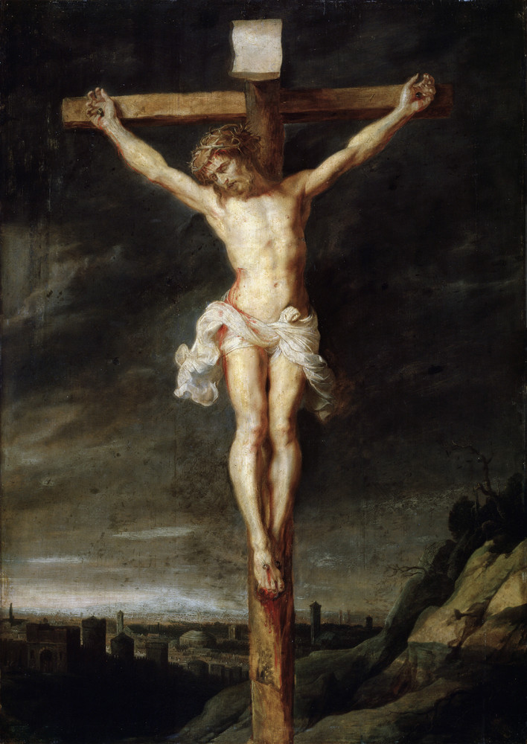
The man on the Shroud has nail wounds in his hands and feet.
It was more common for the Romans to tie a criminal rather than nail the hands, but nailing occurred in some limited accounts. However, crowning a criminal with thorns is distinct to crucified King of the Jews
The gospel accounts indicate that Jesus was nailed in his hands and feet.
Notes:
The man on the Shroud has nail wounds in his hands and feet. It was more common for the Romans to tie a criminal rather than nail the hands, but nailing occurred in some cases. The gospel accounts indicate that Jesus was nailed in his hands and feet.

Slide 24
CROWNED WITH THORNS
SCOURGED
PIERCED BY LANCE
NAILED HANDS AND FEET
Taken together, these details indicate that the Shroud
very accurately depicts Jesus’ distinctive crucifixion,
and is consistent with Roman practices of the time.
Moreover, details of the wounds are result of critical analysis only revealed by both modern historical and scientific research capabilities.
Notes:
Taken together, these details indicate that the Shroud very accurately depicts Jesus’ distinctive crucifixion, and is consistent with Roman practices of the time. Moreover, details of the wounds are beyond the knowledge of a medieval forger.

Slide 25
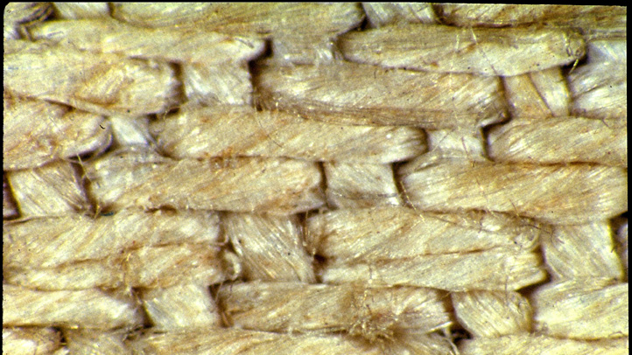
The Image on the Shroud and Evidence of the Resurrection​
Finally, let's look at the mystery of how the image was formed.
We mentioned that a very thorough and comprehensive analytic tests have ruled out any known imaging technologies (paints, dyes, etc. )
In fact, the image is limited to the uppermost surface of the cloth; indeed, the uppermost few fibers making up the visual surface of a strand.
The use of any common imaging techniques from dyes, liquids, vapors, heat, or rubs – any of these would be very easily detected analytically and for some experts even to the human eye.
Notes:
Finally, let's look at the mystery of how the image was formed. We mentioned that tests have ruled out paints, dyes, etcetera. In fact, the image is limited to the uppermost surface of the cloth; indeed, the uppermost surface of the fibers. So the image can’t be made from dyes, liquids, vapors or rubs – any of these would penetrate into the middle of the cloth and leak into nearby fibers (causing blurring of the image).

Slide 26
The image also can’t have been made by scorching
Scorching is easily detectable under fluorescent light -
several fluorescing tests were done that indicated no scorching
(except on parts of the cloth which were burned in the fire of Chambery and which lie outside the body image).
NO SCORCHING
SCORCHING
Notes:
The image also can’t have been made by Scorching, because scorching is easily detectable under fluorescent light, and several fluorescing test were done that indicated no scorching. (Except on parts of the cloth which were burned in the fire of Chambery and which lie outside the body image).

Slide 27
If liquids, vapors, scorching, and other chemical and heat-based causes are ruled out, then scientists are left with only one physical option to explain the image on the shroud:
Light Radiation of a very specific kind
a burst of light
that is extremely brief (so as not to burn or penetrate the cloth)
yet powerful enough to produce
a precise 3D photographic negative on an ordinary cloth.
Notes:
If liquids, vapors, scorching, and other chemical and heat based causes are ruled out, then scientists are left with only one physical option to explain the image on the shroud—radiation of a very specific kind--a burst of light that is extremely brief (so as not to burn or penetrate the cloth) yet powerful enough to produce a precise photographic negative on an ordinary cloth.

Slide 28

In 2010, scientists were able to reproduce a similar image on a cloth with features similar to the shroud.
They produced a short burst of vacuum ultraviolet radiation (one forty-billionth of a second)
with an intensity of about 7 billion watts
with an ArF excimer laser –
12 nanosecond pulses on a linen cloth with spectral reflectance similar to the shroud.
This produced the same sepia color on the uppermost surface of the cloth.
Notes:
In 2010, scientists were able to reproduce a similar image on a cloth with features similar to the shroud. They produced a short burst of vacuum ultraviolet radiation (one forty-billionth of a second) with an intensity of about 7 billion watts with an ArF excimer lasers - 12 nanosecond pulses on a linen cloth with spectral reflectance similar to the shroud. This produced the same sepia color on the uppermost surface of the cloth

Slide 29
Dr. Paolo Di Lazzaro noted that to use this effect to make an image the size of the shroud would
require precise position of 14,000 of these lasers which is more than what is available to us even today.
Yet this burst of radiation somehow happened to the cloth wrapped around the man of the Shroud.
There is no known natural cause to explain how this could happen.
Notes:
Dr. Paolo Di Lazzaro noted that to use this effect to make an image the size of the shroud would require 14,000 of these lasers - more than exist in every laboratory in the world today. Yet this burst of radiation somehow happened to the cloth wrapped around the man of the Shroud. There is no known natural cause to explain how this could happen.

Slide 30
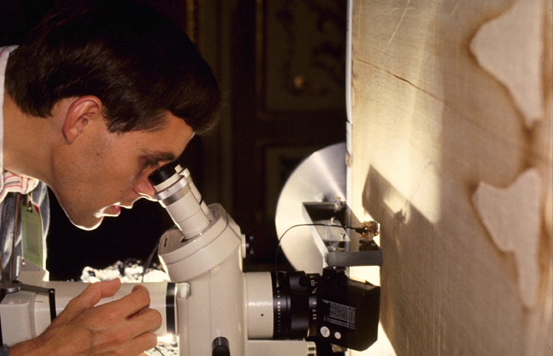
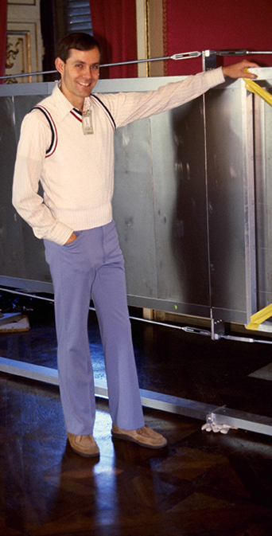
Photos ©1978 Barrie M. Schwortz Collection, STERA, Inc.
The analysis of Physicist Dr. John Jackson adds one final mystery.
He found that the three-dimensional volumetric characteristics of the image could only be explained if the cloth had collapsed into and through the upright body as a whole while the body was emitting its burst of light.
For example, the bones inside the hand and the flesh surrounding those bones can be segmented into a perfect three-dimensional image analyzer (like an MRI) which requires that the cloth penetrates into the body at least three-sixteenths of an inch.
In other words, the body had to become mechanically transparent, like a spiritual body.
Notes:
The analysis of Physicist Dr. John Jackson adds one final mystery. he found that the three-dimensional volumetric characteristics of the image could only be explained if the cloth had collapsed into and through the body as a whole while the body was emitting its burst of light. For example, the bones inside the hand and the flesh surrounding those bones can be segmented into a perfect three-dimensional image analyzer (like an MRI) which requires that the cloth penetrates into the body at least three-sixteenths of an inch. In other words, the body had to become mechanically transparent, like a spiritual body.

Slide 31
Do we need a supernatural explanation for The Shroud image?
The current understanding of the laws of physics cannot explain a transition from a physical to a spiritual body or a burst of several billion watts of light energy from a corpse with this level of specificity.
So what are our options?
We can reasonably infer the strong possibility that there’s a supernatural cause—or
We can attempt to reasonably infer a technology not known to us today is the natural cause, requiring a whole new explanation of physics and chemistry to support this claim either now or in the future.
Notes:
The current understanding of the laws of physics cannot explain a transition from a physical to a spiritual body or a burst of several billion watts of light energy from a corpse. So what are our options?
We can reasonably infer the strong possibility that there’s a supernatural cause—or
We can wait for a whole new explanation of physics and chemistry that might emerge in the future to solve the mystery.

Slide 32
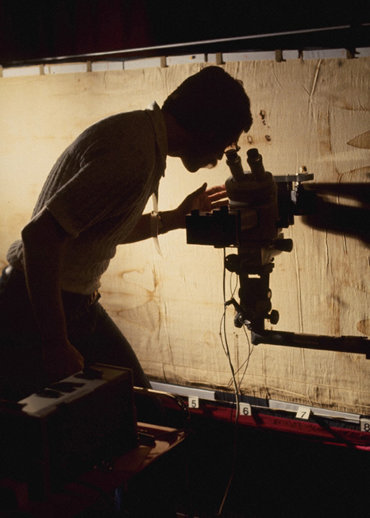
Photo ©1978 Barrie M. Schwortz Collection, STERA, Inc.
Either way, these are the most inexplicable phenomena to come from any artifact in history.
When you consider that the shroud of Turin is
the most scientifically tested artifact
and the most distinctive image known to humankind,
it should at least cause us to think of
what it might mean about Jesus,
and what it means for us.
Notes:
Either way, these are the most inexplicable phenomena to come from any artifact in history. When you consider that the shroud of Turin is the most scientifically tested artifact and the most unique image known to humankind, it should at least cause us to think of what it might mean about Jesus, and what it means for us.

Slide 33
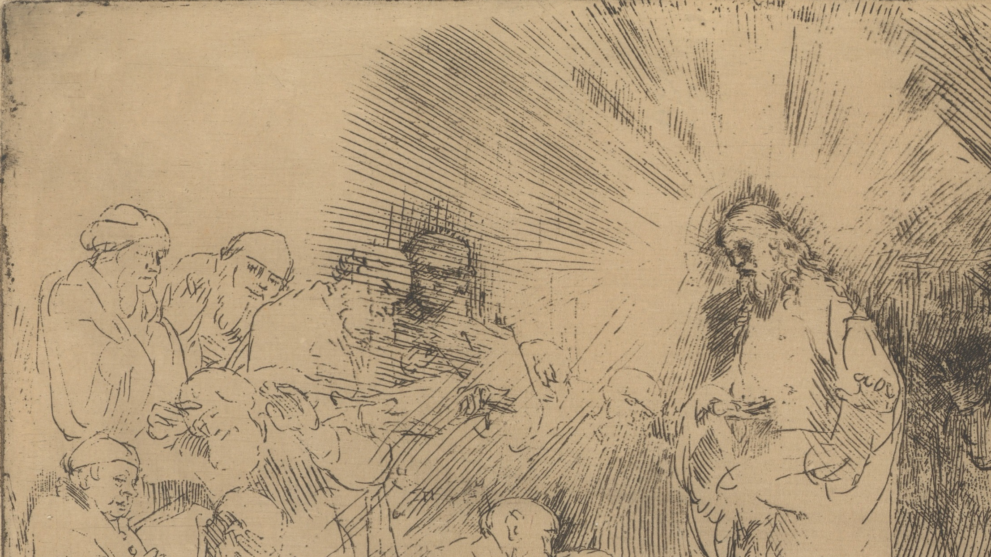
These two inexplicable characteristics
a huge burst of radiating light
and a spiritual body
also match the characteristics of Jesus' risen body
indicated by the Gospels and St. Paul.
Remember that Christianity broke with the doctrine of Judaism in only one major respect—the resurrection.
Jewish doctrine: the resurrection would be a restoration of our physical bodies
Christians: the resurrection would be glorious, powerful, and spiritual (based on their experience of the risen Christ)
Isn’t it interesting that these departures from Jewish doctrine to that of Christians just happen to correspond to the
two extraordinary phenomena on the shroud of Turin?
Notes:
These two inexplicable characteristics - a huge burst of radiating light and a spiritual body - also match the characteristics of Jesus' risen body indicated by the gospels and St. Paul.
Remember that Christianity broke with the doctrine of Judaism in only one major respect—the resurrection. Though Jewish doctrine held that the resurrection would be a restoration of our physical bodies, Christians insisted that the resurrection would be glorious, powerful, and spiritual, based on their experience of the risen Christ. Isn’t it interesting that these departures from Jewish doctrine just happen to correspond to the two extraordinary phenomena on the shroud of Turin?

Slide 34
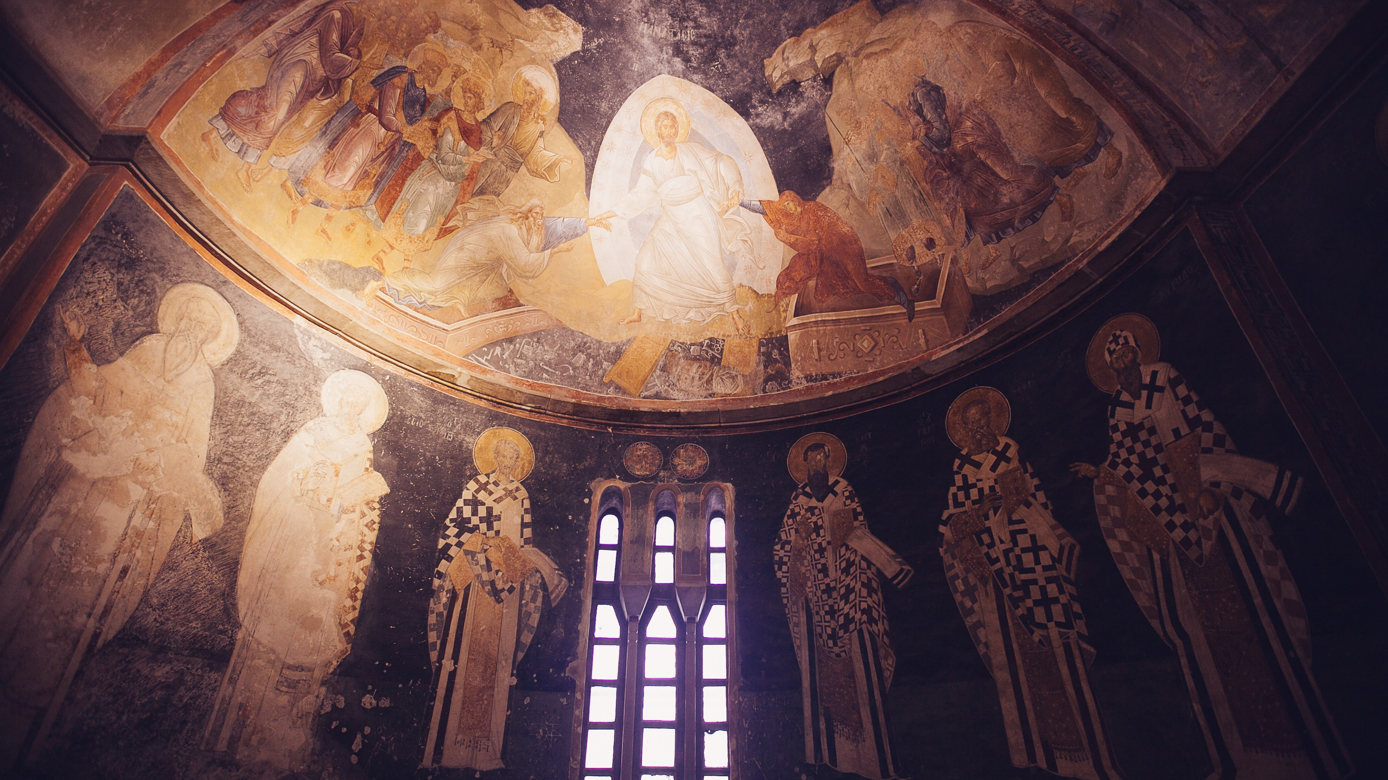
What can we conclude?
The Shroud of Turin not only affirms the likelihood of Jesus’ spiritual resurrection,
it also implies the accuracy of the Gospel resurrection narratives and St. Paul’s testimony.
Notes:
What can we conclude? The Shroud of Turin not only affirms the likelihood of Jesus’ spiritual resurrection, it also implies the accuracy of the gospel resurrection narratives and St. Paul’s testimony.

Slide 35
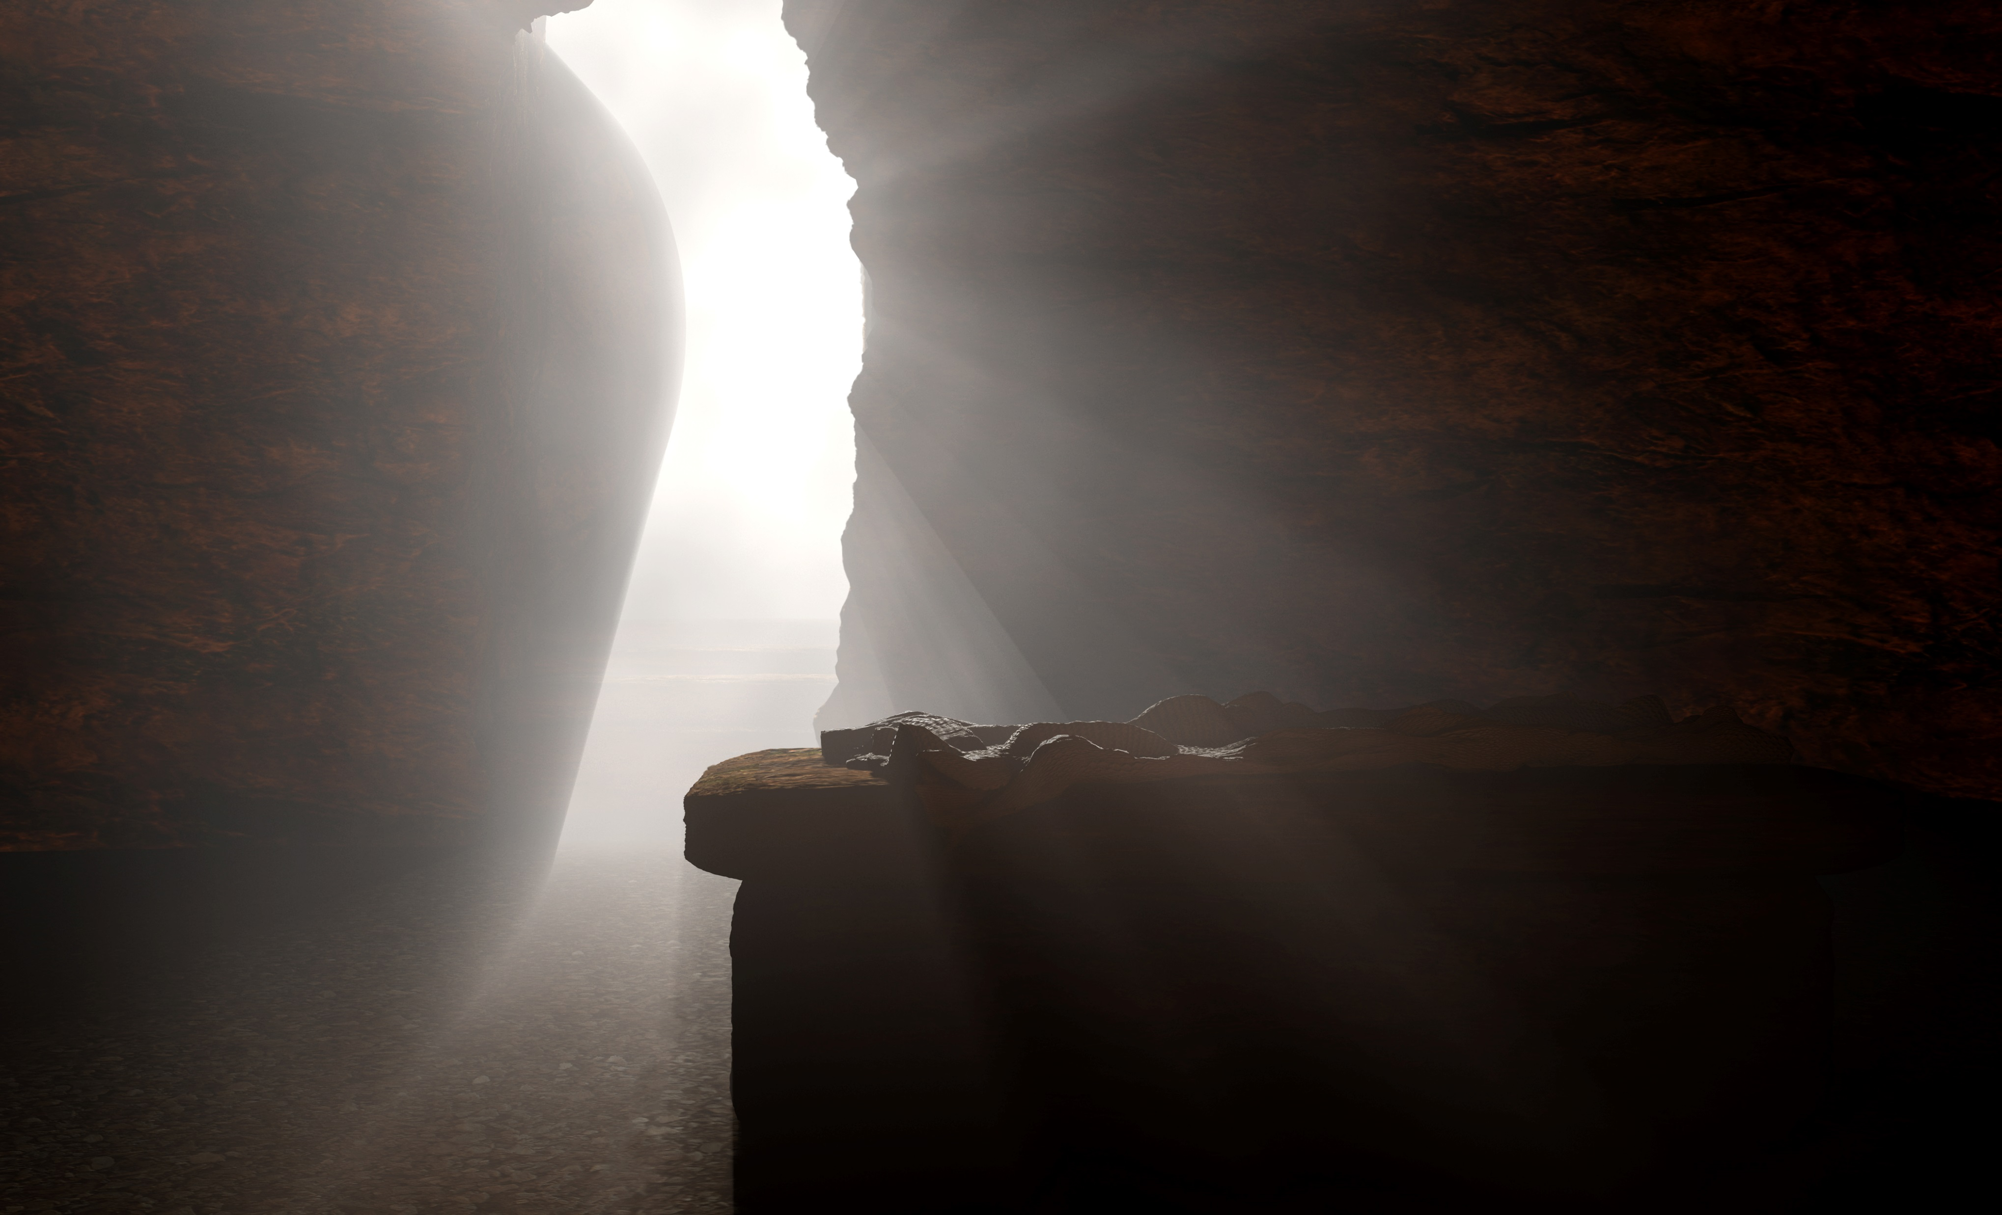
Given all this, we might reasonably infer that the Shroud is the burial cloth of Jesus – a relic of his crucifixion and his glorious spiritual resurrection.
In conclusion, the Shroud can give plausible scientific evidence that deepens our understanding of Jesus' life, but our faith does not have to depend on it.
Notes:
Given all this, we might reasonably infer that the Shroud is the burial cloth of Jesus - a relic of his crucifixion and his glorious spiritual resurrection . In conclusion, the Shroud can give plausible scientific evidence that deepens our understanding of Jesus' life, but our faith does not have to depend on it.

Slide 36

Activity
With the person beside you, list at least 3 points as to why the Shroud affirms the resurrection for further class discussion.

Slide 37
Various tests done on the shroud suggest
that it could be the burial shroud of Christ,
due to the combination of three kinds of evidence:
Anatomical details that correspond to the unusual set of injuries described in the gospels, historical Roman-style crucifixions, and relative images of Christ
Ultra, ultra high-energy image formation implying a spiritual and glorious Resurrection
Dating analyses that place it at the time of Christ

Slide 38
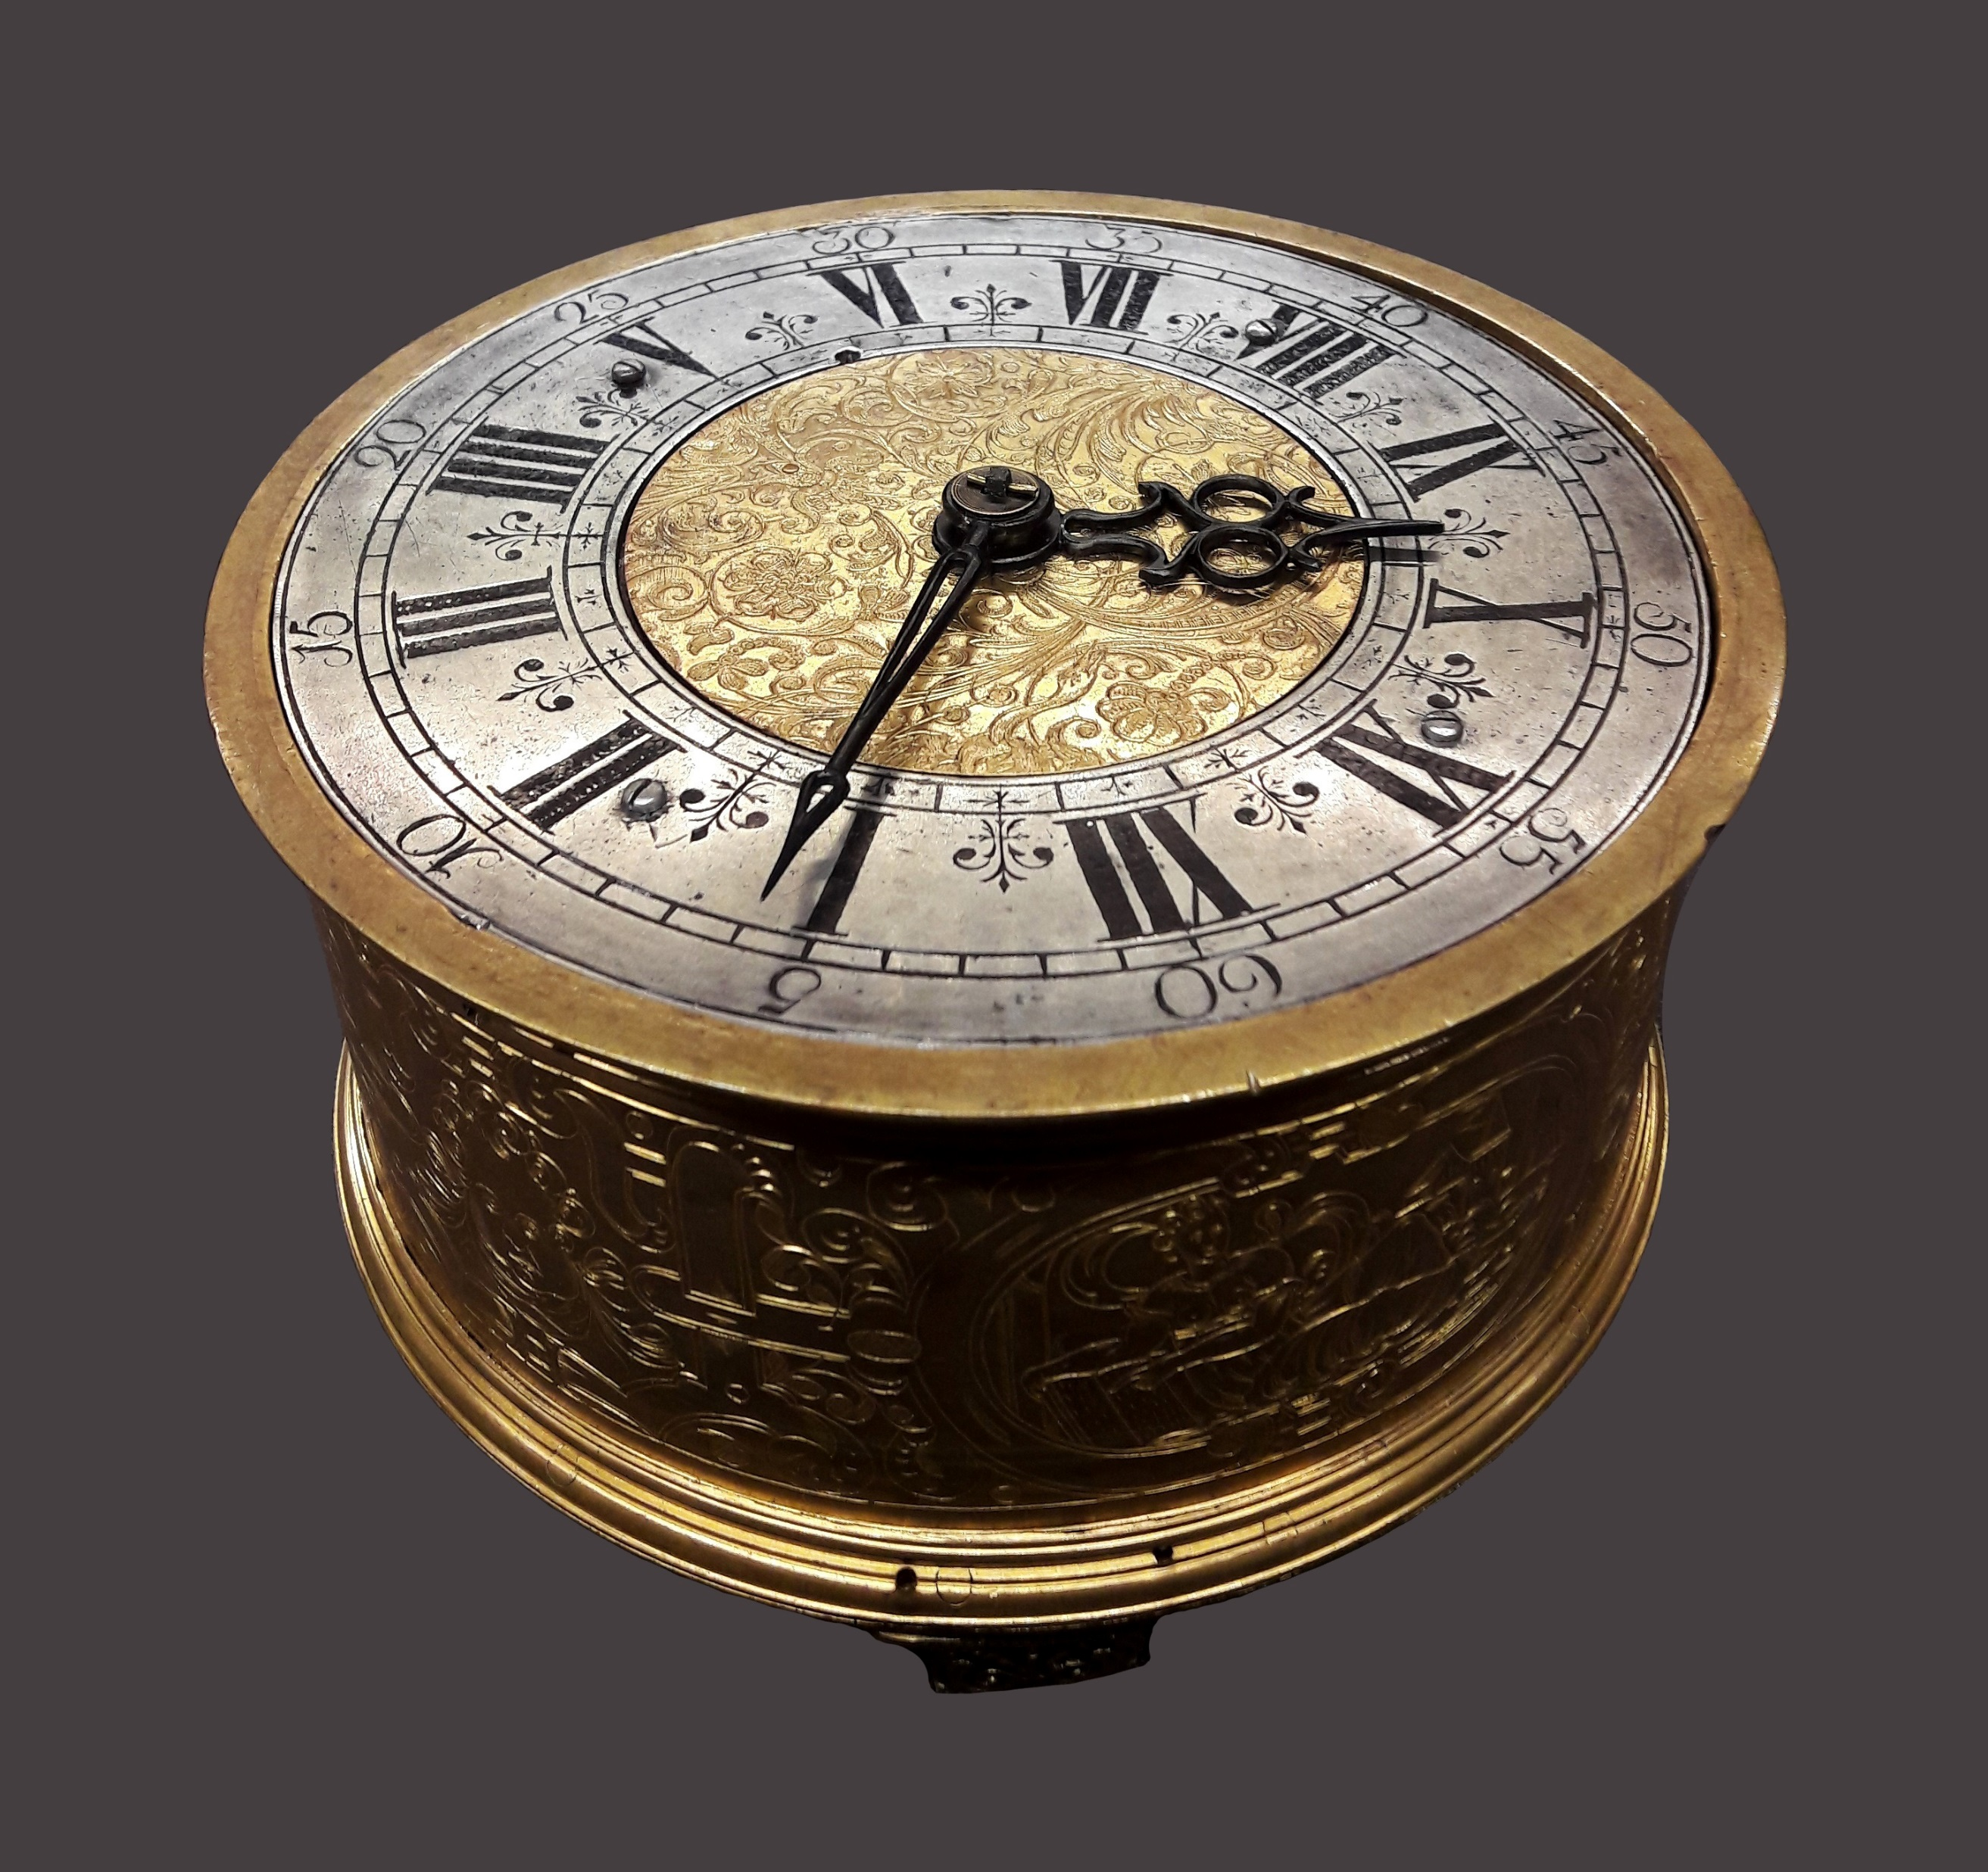
Dating the Shroud
Before we look at the new dating methods which place the Shroud in the time of Christ,
we should address the one test that seems not to match these findings.
A radiocarbon-14 test in 1988
took a sample of the shroud and dated it between 1260 and 1390 AD.
Notes:
Before we look at the new dating methods which place the Shroud in the time of Christ, we should address the one test that seems not to match these findings. A radiocarbon-14 test in 1988 took a sample of the shroud and dated it between 1260 and 1390 AD.

Slide 39

Keyword: Radiocarbon-14 dating
Radiocarbon-14 dating is a way of finding out the age of archaeological artefacts which contain carbons atoms e.g., wood, biological materials, ancient mummies, etc.
Radiocarbon-14 is a radioactive isotope that due to its nuclear instability decays at a fixed rate back to nitrogen over time. Scientists can work backwards from the current level of Radiocarbon-14 in an artefact to calculate how old the artefact is, assuming the initial source of carbon to be measured hasn’t changed.
Notes:
Carbon 14 dating is a way of finding out the age of archaeological artefacts which contain biological material, e.g., wood, ancient mummies, etc. Biological material contains Carbon 14 but when a plant or animal dies, the level of Carbon 14 in its remains steadily decreases over time. Scientists can work backwards from the current level of Carbon 14 in a biological artefact to calculate how old the artefact is.

Slide 40
Activity
In groups of 3-4 students, you are tasked to develop a brief list of “must haves” for the protocol that will be used to guide the sampling and analysis of The Shroud of Turin by radiocarbon dating to guarantee its validity. Tip: Focus on the most important elements of the protocol that must not be violated based on your knowledge of sound scientific standards for testing materials.

Slide 41

Key elements of the protocol that were proposed by assigned physicist Harry Grove (University of Rochester) approved by Vatican.
Samples were to be taken from multiple areas away from any known discontinuity of the fabric, such as patches or charred areas. (Suggested 7 areas based 1978 STURP findings)
Comprehensive examination would be simultaneous
Multiple labs would participate in the testing (Suggesting 7 labs)
Comparisons with indistinguishable, blind control fibers
No exchange of information would be allowed during the testing
Was anything left out?
Was this agreed upon protocol followed?

Slide 42
Key elements of the protocol that were proposed by assigned physicist Harry Grove (University of Rochester) approved by Vatican.
Samples were to be taken from multiple areas away from any known discontinuity of the fabric, such as patches or charred areas. (NONE of suggested 7 areas based 1978 STURP findings)
Comprehensive Examination would be simultaneous (Abandoned)
Multiple labs would participate in the testing (3 labs)
Comparisons with indistinguishable, blind control fibers (Abandoned)
No exchange of information would be allowed during the testing (Abandoned)
X
X
X
X
X
For political reasons, the proposed protocol was essentially abandoned with the main argument to limit the number of samples to protect and better preserve the Shroud.

Slide 43
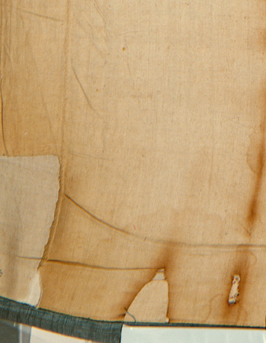
Photo ©1978 Barrie M. Schwortz Collection, STERA, Inc.
As a rule, Radiocarbon-14 is a reliable measuring tool.
In this case, it seems the sample was taken from an area where the Shroud was repaired (patched) after a fire in 1532. There is considerable evidence that the sample contained material from the threads used to repair the Shroud rather than the original Shroud material.
At the very least
some later fibers used to repair the site
were mixed with the original fibers
in the sample used for the carbon-14 dating.
Notes:
As a rule, Carbon-14 is a reliable measuring tool. In this case, it seems the sample was taken from an area where the Shroud was patched after a fire in 1532, in which the original cloth was not actually being tested. At the very least some later fibers from the patch were mixed with the original fibers in the sample used for the carbon-14 dating.

Slide 44
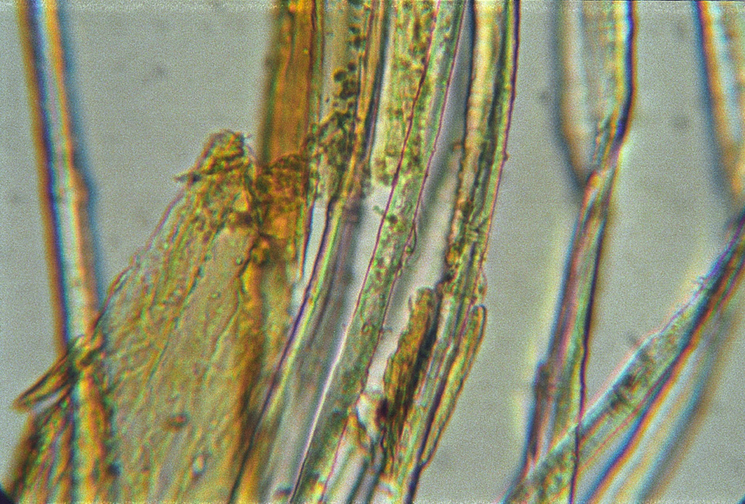
Photo ©2005 Raymond N. Rogers Collection, STERA, Inc.
Dr. Raymond Rodgers
of Los Alamos Laboratories confirmed this
when he tested the sample
and found cotton fibers in the sample
(the original shroud is linen).
Furthermore, he found a dye coating
(the actual Shroud has no dye and this sample was presumably dyed to match the cloth it was patching).
Notes:
Dr. Raymond Rodgers of Los Alamos Laboratories confirmed this when he tested the sample and found cotton fibers in the sample (the original shroud is linen). Furthermore, he found a dye coating (the actual Shroud has no dye and this sample was presumably dyed to match the cloth it was patching).

Slide 45
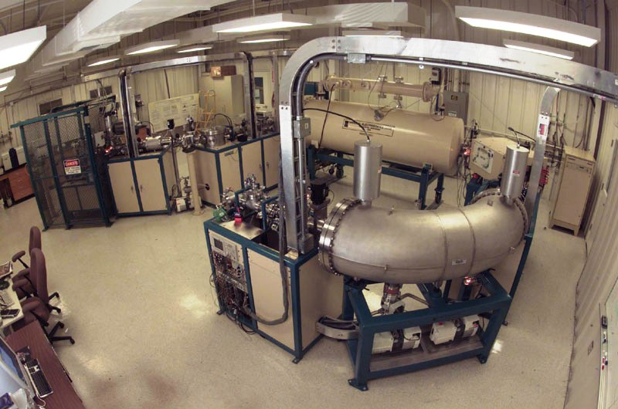
A 2017 analysis led by French researcher Tristan Casabianca reached the same conclusion: "Our statistical analysis shows that the 1988 radiocarbon 14 dating was unreliable...It is therefore impossible to conclude that the shroud of Turin dates from the Middle Ages.” Casabianca found so much stratification in the samples that dating it to the middle ages is highly unlikely. Thus, ​a new radiocarbon test with more diverse samples from less controversial areas of the shroud should be arranged.
Let's turn now to the other dating methods that have recently been found.
Notes:
A 2017 analysis led by French researcher Tristan Casabianca reached the same conclusion, stating "Our statistical analysis shows that the 1988 carbon 14 dating was unreliable...It is therefore impossible to conclude that the shroud of Turin dates from the Middle Ages.” Casabianca found so much stratification in the samples that dating it to the middle ages is highly unlikely. Thus ​a new carbon test with more diverse samples from less controversial areas of the shroud should be arranged.
Let's turn now to the other dating methods that have recently been found.

Slide 46
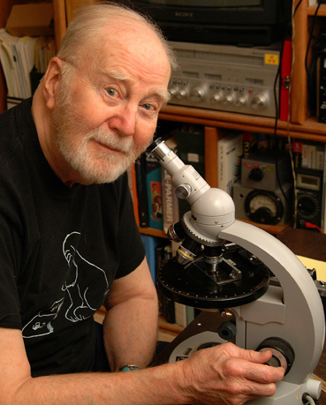
Photo ©2004 Barrie M. Schwortz Collection, STERA, Inc.
Four New Scientific Dating Methods
A variety of dating methods place the Shroud's origins much nearer to the 1st century.
Dr. Raymond Rogers
performed a vanillin test which compares the amount of vanillin remaining in different linens from different ages.
Since vanillin — like carbon — decays with age, scientists can make an estimate of how old a cloth is by detecting its level of vanillin residue.
In this comparison, the Shroud's results placed the shroud's origin at a much earlier date—the 1st century before Christ.
Notes:
A variety of dating methods place the Shroud's origins much nearer to the 1st century.
Dr. Raymond Rogers performed A Vanillin test which compares the amount of vanillin remaining in different linens from different ages. Since vanillin like carbon, decays with age scientists can make an estimate of how old a cloth is by detecting its level of vanillin residue. In this comparison, the Shroud's results placed the shroud's origin at a much earlier date—the first centuries before Christ.

Slide 47
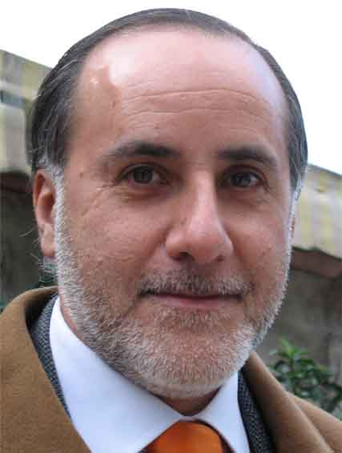
Dr. Giulio Fanti performed three additional dating tests.
The first test , cellulose decay, compared textiles of different ages to establish the rate at which another decaying compound, cellulose, disappears over time. The Shroud's results produced an origin range of
700 BC to 100 AD
A variation of this test, using Raman lasers to probe the samples, produced a range of
700 BC to 300 AD.
Finally, a series of mechanical tests compared the physical properties of ancient fabrics, like the tensile strength of individual fibers. In this comparison, the Shroud's origin range was
1 AD-800 AD
Notes:
Dr. Giulio Fanti performed three additional dating tests. The first test compared textiles of different ages to establish the rate at which another decaying compound, cellulose, disappears over time. The Shroud's results produced an origin range of 700 BC to 100 AD
A variation of this test, using Raman lasers to probe the samples, produced a range of 700BC to 300 AD.
Finally, a series of mechanical tests compared the physical properties of ancient fabrics, like the tensile strength of individual fibers. In this comparison, the Shroud's origin range was 1 AD-800 AD

Slide 48
700 BC
600
500
400
300
200
100
1 AD
100
200
300
400
500
600
700
800
AD
33
If we average the means of all three of Fanti’s tests, the origin of the Shroud might be placed at around 33 BC
(plus or minus 150 years with a 95% confidence level)
—very close to the time of Jesus.
Notes:
If we average the means of all three of Fanti’s tests, the origin of the Shroud might be placed at around 33 BC (plus or minus 150 years with a 95% confidence level)—very close to the time of Jesus.

Slide 49
What are the four types of dating that appear to indicate the possibility that the Shroud of Turin originated around the first century?
Let’s review

Slide 50
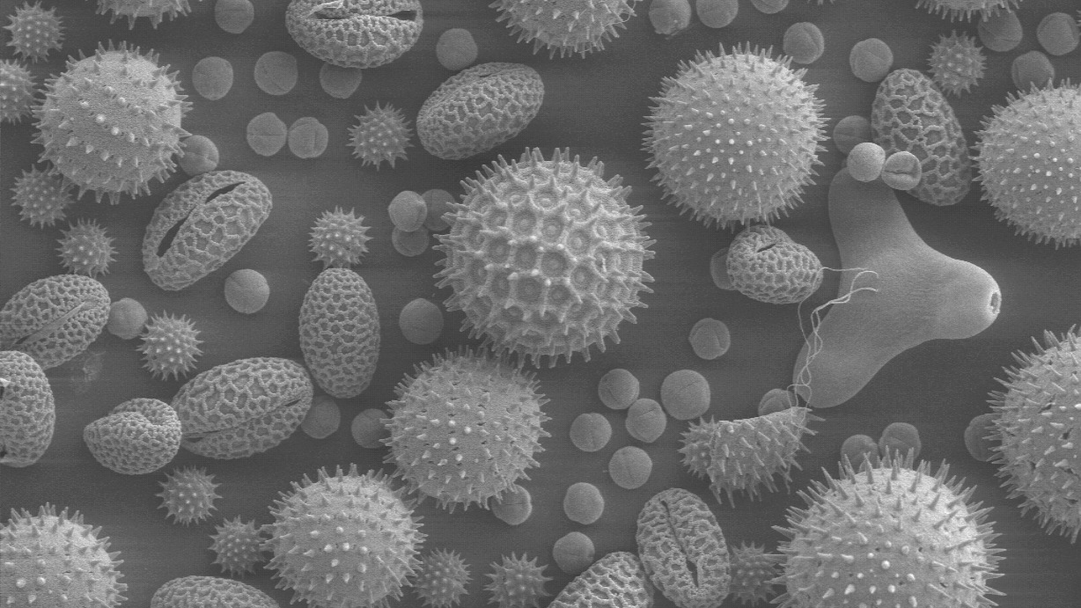
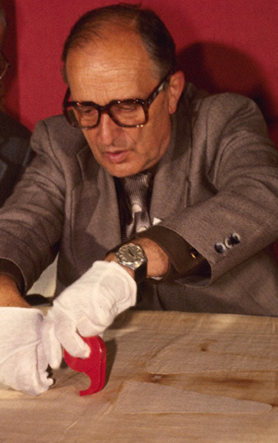
Photo Max Frei ©1978 Barrie M. Schwortz Collection, STERA, Inc.
Other Indications of the Shroud's Age
Pollen grains
A Swiss botanist and criminologist named Max Frei took samples of pollen grains from the Shroud and identified 58 grains by comparing them to pollen grains in botanical museums.
45 from Israel, specifically from 2000 year old sediment deposits near the Sea of Galilee.
6 from the Middle East, including Edessa and Constantinople
The rest from France and Italy, the countries where the shroud has been since the middle ages.
The preponderance of 2000-year-old Israel-based pollen not only helps locate the Shroud's origin, it makes a medieval forgery unlikely.
Notes:
A Swiss botanist and criminologist named Max Frei took samples of pollen grains from the Shroud and identified 58 grains by comparing them to pollen grains in botanical museums. 45 were from Israel, specifically from 2000 year old sediment deposits near the Sea of Galilee. 6 were from the middle east, including Edessa and Constantinople, and the rest from France and Italy, the countries where the shroud has been since the middle ages. The preponderance of 2000-year-old Israel-based pollen not only helps locate the Shroud's origin, it makes a medieval forgery unlikely.

Slide 51
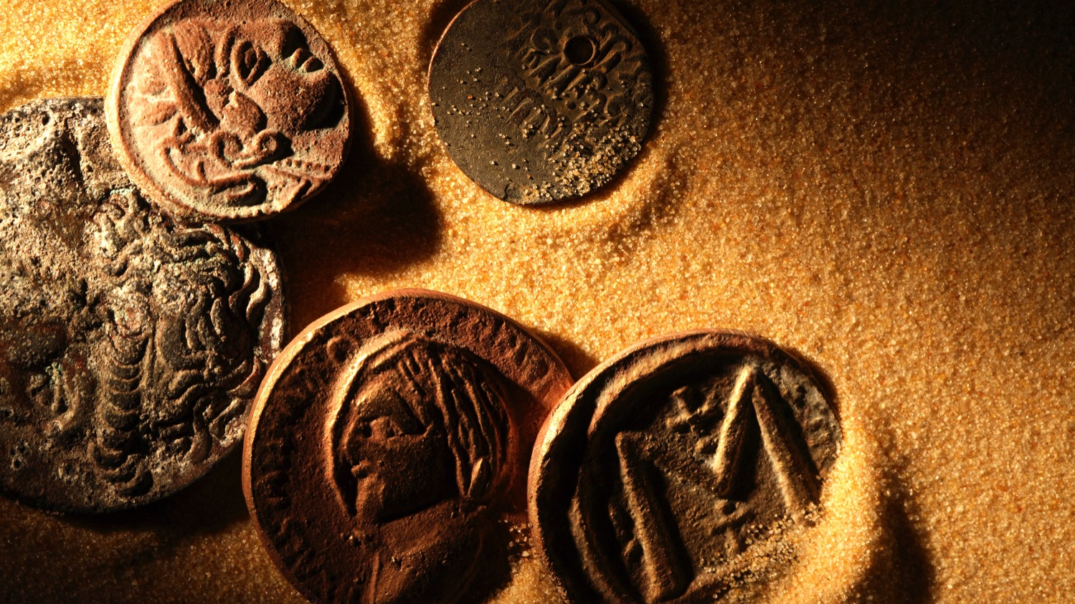

Other Indications of the Shroud's Age
Imprints of Ancient Coins
Numismatics is the study of coins and other currency.
Numismatists have identified partial imprints of coins
laid on the eyes of the man in the Shroud.
Overlaid photographs correlate these coins
with a specific variant of a type of coin minted in Judea
in 29 AD by Pontius Pilate.
Notes:
Numismatics is the study of coins and other currency. Numismatists have identified partial imprints of coins laid on the eyes of the man in the Shroud. Overlaid photographs correlate these coins with a specific variant of a type of coin minted in Judea in 29 AD by Pontius Pilate.

Slide 52
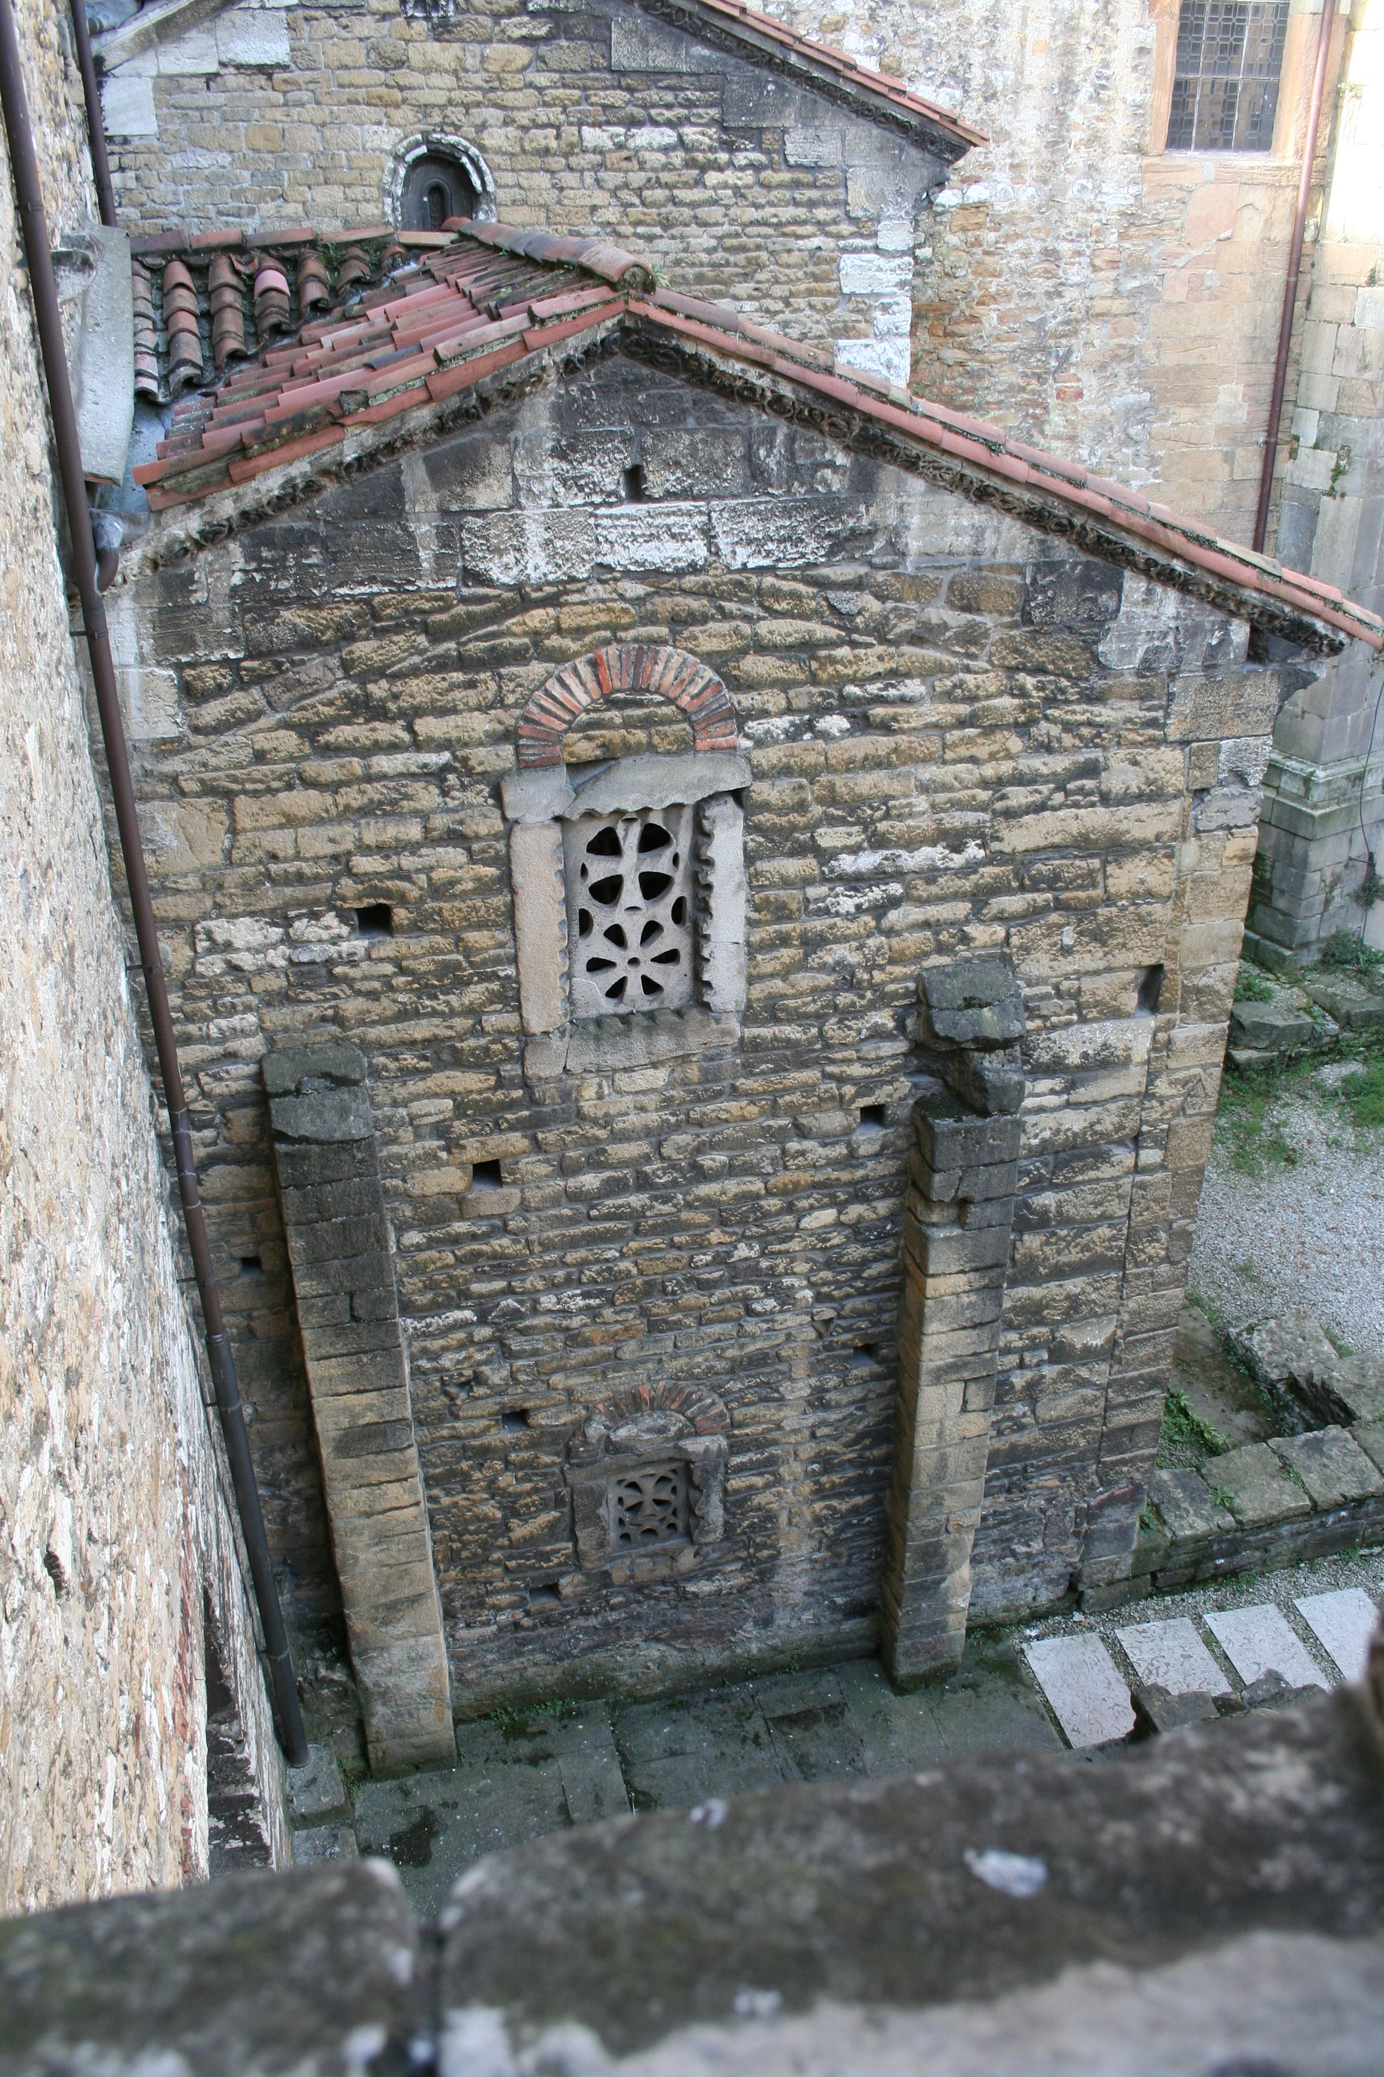
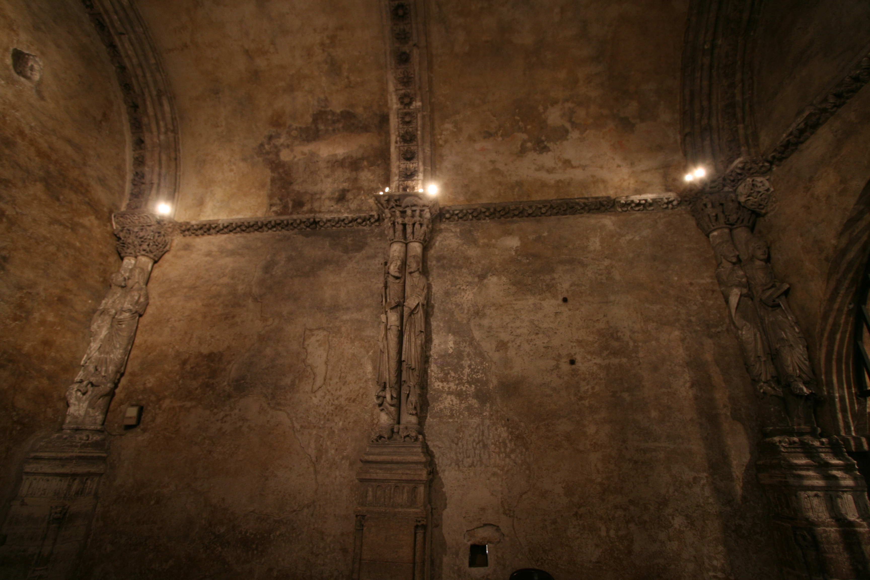
Other Indications of the Shroud's Age
Similarities to the Facecloth of Oviedo
The Facecloth of Oviedo is a bloodstained cloth (without an image) housed in a Spanish Cathedral since the 7th century.
It was used to wrap the face and head of a man crowned with thorns and severely beaten around the face.
The Facecloth of Oviedo and the Shroud have virtually identical blood stains with 120 points of overlap (as detected by digital overlay photography).
This strongly implies that they touched the same face: odds against getting 120 points of correlation of irregular blood stains on two cloths by pure chance is astronomically high.
Notes:
The Facecloth of Oviedo is a bloodstained cloth (without an image) housed in a Spanish Cathedral since the 7th century. It was a face cloth used to wrap the face and head of a man who had been crowned with thorns and severely beaten around the face. Interestingly, the facecloth of Oviedo and the facial image on the Shroud have virtually identical blood stains in exactly the same places, with 120 points of overlap (as detected by digital overlay photography). This strongly implies that they touched the same face because the odds against getting 120 points of correlation of irregular blood stains on two cloths by pure chance is astronomical.

Slide 53
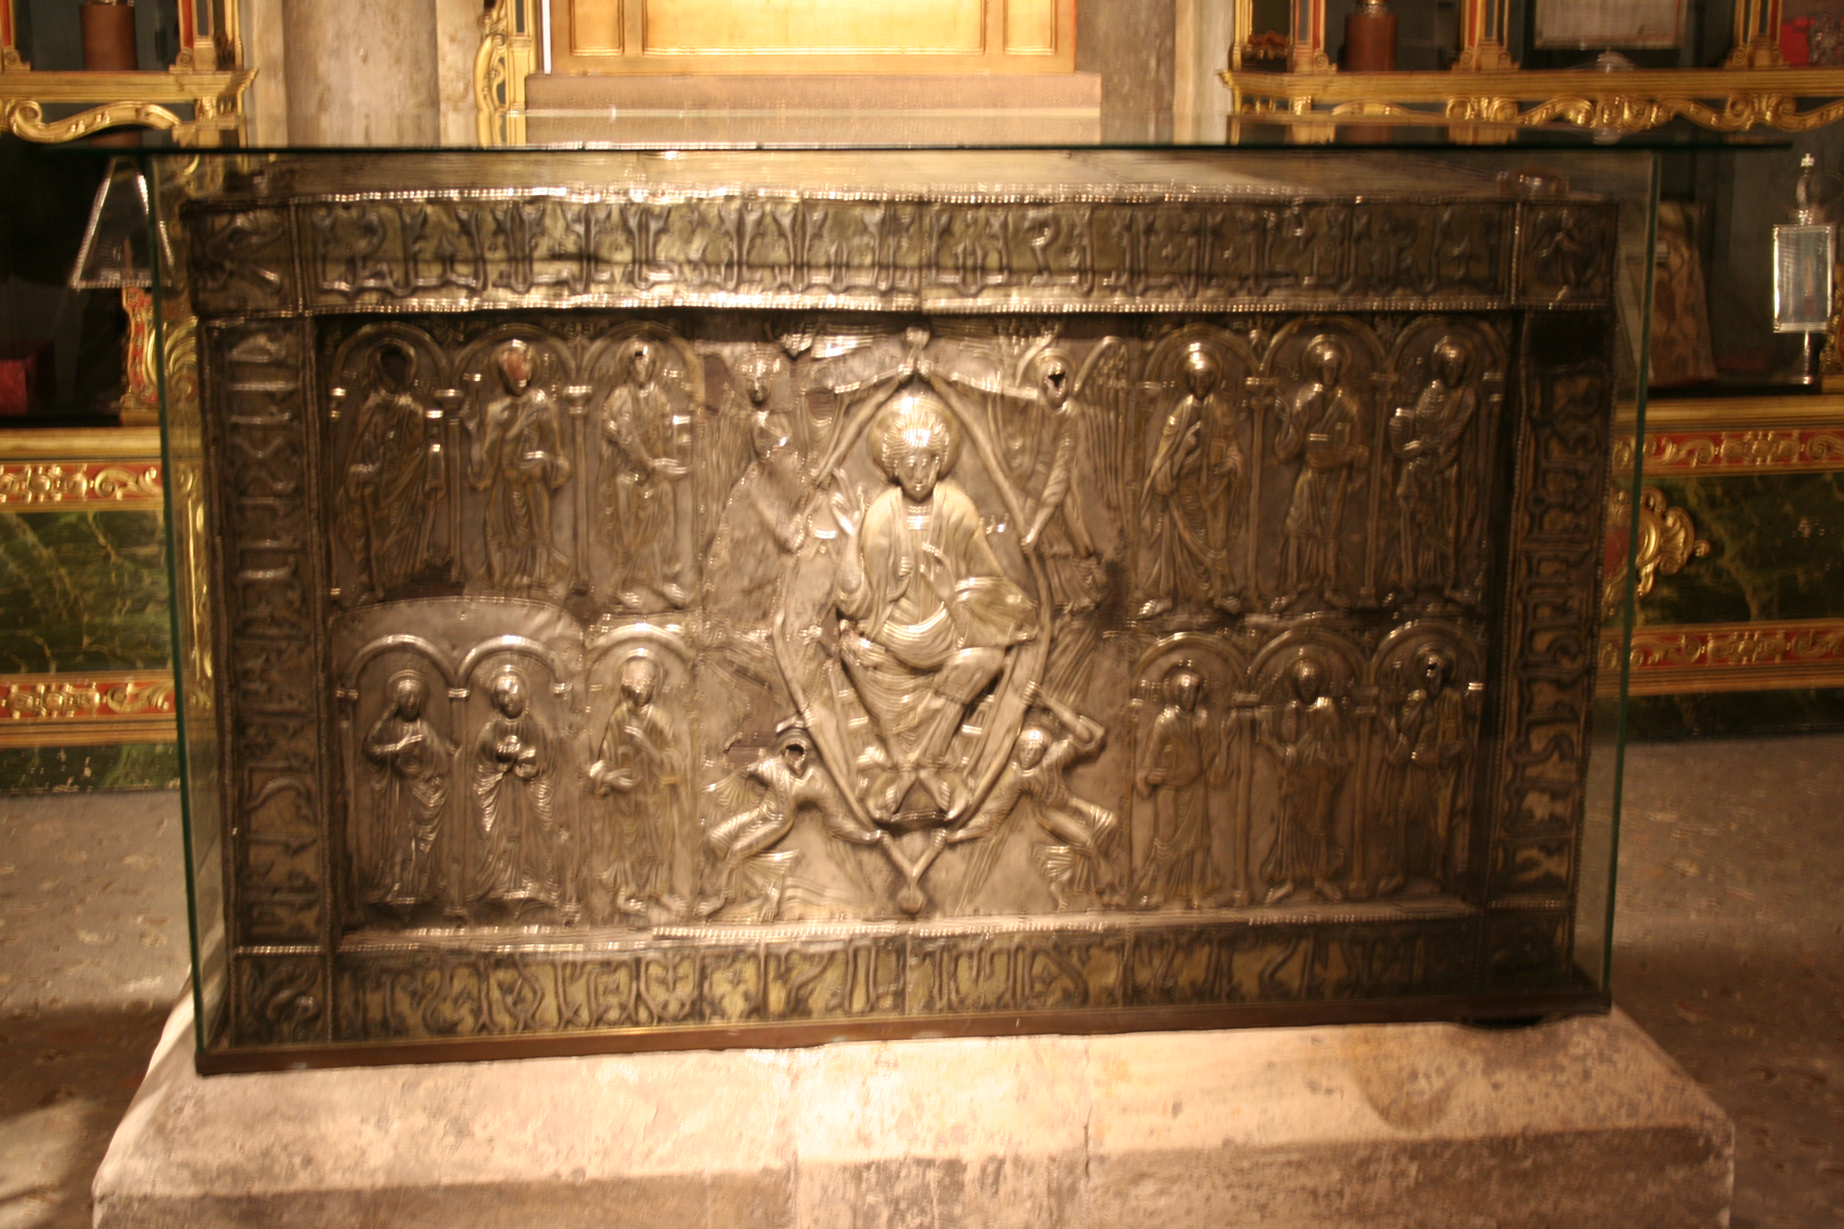
Other Indications of the Shroud's Age
Similarities to the Facecloth of Oviedo
This is significant for dating the Shroud because the Facecloth of Oviedo has a continuous recorded history from 616 AD
making the Shroud at least 780 years older than the 1988 carbon dating indicated.
Notes:
This is significant for dating the Shroud because the Facecloth of Oviedo has a continuous recorded history from 616 AD, making the Shroud at least 780 years older than the 1988 carbon dating indicated.

Slide 54
Outside of the dating techniques mentioned above,
what three other types of considerations suggest a dating of the Shroud of Turin long before the Middle Ages?
Let’s review

Slide 55
Photo Dr. Rogers ©2004 Barrie M. Schwortz Collection, STERA, Inc.
When we combine the evidence of the pollen samples the Roman coins and the Facecloth of Oviedo
with the four new dating methods of Dr. Ray Rogers and Dr. Giulio Fanti
it gives strong probative evidence that the Cloth originated in First Century Palestine around the time of Jesus’ crucifixion.
Notes:
When we combine the evidence of the pollen samples, the Roman coins, and the Facecloth of Oviedo with the four new dating methods of Dr. Ray Rogers and Dr. Giulio Fanti, it gives strong probative evidence that the Cloth originated in First Century Palestine around the time of Jesus’ crucifixion.

Slide 56
700 BC
600
500
400
300
200
100
1 AD
100
200
300
400
500
600
700
800
AD
33
1. Three dating tests and three circumstantial factors indicate a probable origin before 600 AD – and likely, the 1st century.
Notes:
1. Three dating tests and three circumstantial factors indicate a probable origin before 600 AD – and likely, the 1st century.

Slide 57
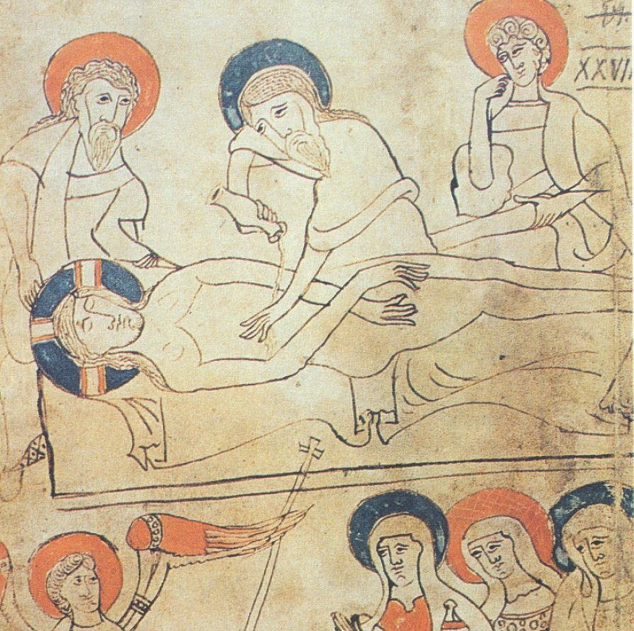
2. A medieval forger could not have had access and thus knowledge of the historical details of the crucifixion from the Roman period.
Notes:
2. A medieval forger could not have known or replicated the historical details of the crucifixion from the Roman period.

Slide 58
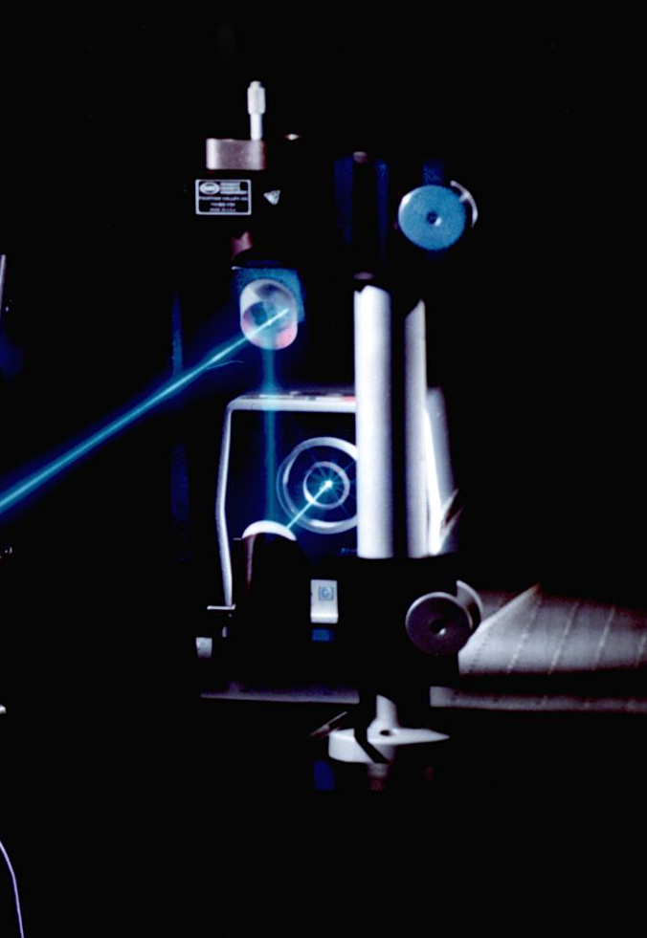
3. No one even with access to all the current technologies know today could have replicated the scientifically-unique image formation
even with the use of lasers and other laboratory equipment—quite beyond a medieval forger.
Notes:
3. No one without an excellent knowledge of physics prior to the late twentieth century could have replicated the scientifically-unique image formation without the use of lasers and other laboratory equipment—quite beyond a medieval forger.

Slide 59

4. We still do not have the capacity to replicate a spiritual body, and no one prior to the late twentieth century could have known about it,
because it requires a digital image analyzer to discern the segmented three-dimensional information on the image of the Shroud—
quite beyond a medieval forger.
Notes:
4. We still do not have the capacity to replicate a spiritual body, and no one prior to the late twentieth century could have known about it, because it requires a digital image analyzer to discern the segmented three-dimensional information on the image of the Shroud—quite beyond a medieval forger.

Slide 60
Is the Shroud the burial cloth of Jesus?
The odds of this burial Shroud —with the distinct features of Jesus’ crucifixion and resurrection— being anyone's but Jesus’ is very remote.
Notes:
The odds of this burial Shroud—with the unique features of Jesus’ crucifixion and resurrection—being anyone's but Jesus’ is very remote. This is substantiated by four scientifically and historically analyzed facts:

Slide 61
“Before the Shroud, the intense and agonizing image of an unspeakable torment, I wish to thank the Lord for this unique gift, which asks for the believer's loving attention and complete willingness to follow the Lord.”
Pope St. John Paul II during a Pastoral Visit to Turin in 1998

Slide 62
Activity
With the person beside you, list the four facts that point to the Shroud being the burial cloth of Christ. List any evidence that might refute these facts and/or point to the Shroud not being the burial cloth of Christ. We divide the class into 2 groups and debate the evidence for and against the Shroud being the burial cloth of Christ.

Slide 63
Your opinion matters!
Please access and complete the Edulastic Assignment – Introduction to The Shroud of Turin

Slide 64


Closing Prayer
Lord, we thank You for giving us the ability to discover the truth about our souls, Heaven and above all your Son.
We thank you for the evidence of the mind, the direction and inspiration of your Holy Spirit, and your presence in our hearts and in the world around us.
Help us to surrender to the teaching of your son so that we might be with you and all the Blessed in your kingdom of joy forever.
Amen.​
Notes:
Lord, we thank You for giving us the ability to discover the truth about our souls, Heaven and above all your Son.
We thank you for the evidence of the mind, the direction and inspiration of your Holy Spirit, and your presence in our hearts and in the world around us.
Help us to surrender to the teaching of your son so that we might be with you and all the Blessed in your kingdom of joy forever.
Amen.

Slide 65
A special thanks to Fr.Robert Spitzer and his Magis Center Team!
Please access a wealth of additional resources at magiscenter.com and other related educational faith and science content at crediblecatholic.com
Notes:
Credible Catholic presents the 7 Essentials: Module 4 Appendix – The Shroud of Turin

